Slide 1
Free Software Slides
Copyright 2014,16,17,18 Christian Noguera, Valentin Pasquier, Ubaldo Boyano Adánez,
David Osgood, Richard Stallman
Released under CC-BY 3.0 license

Slide 2
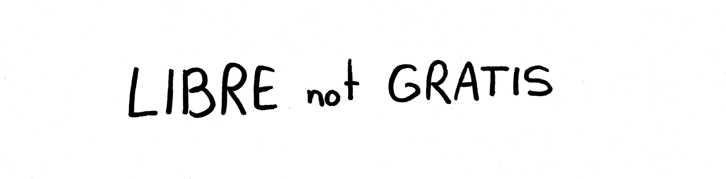

Slide 3
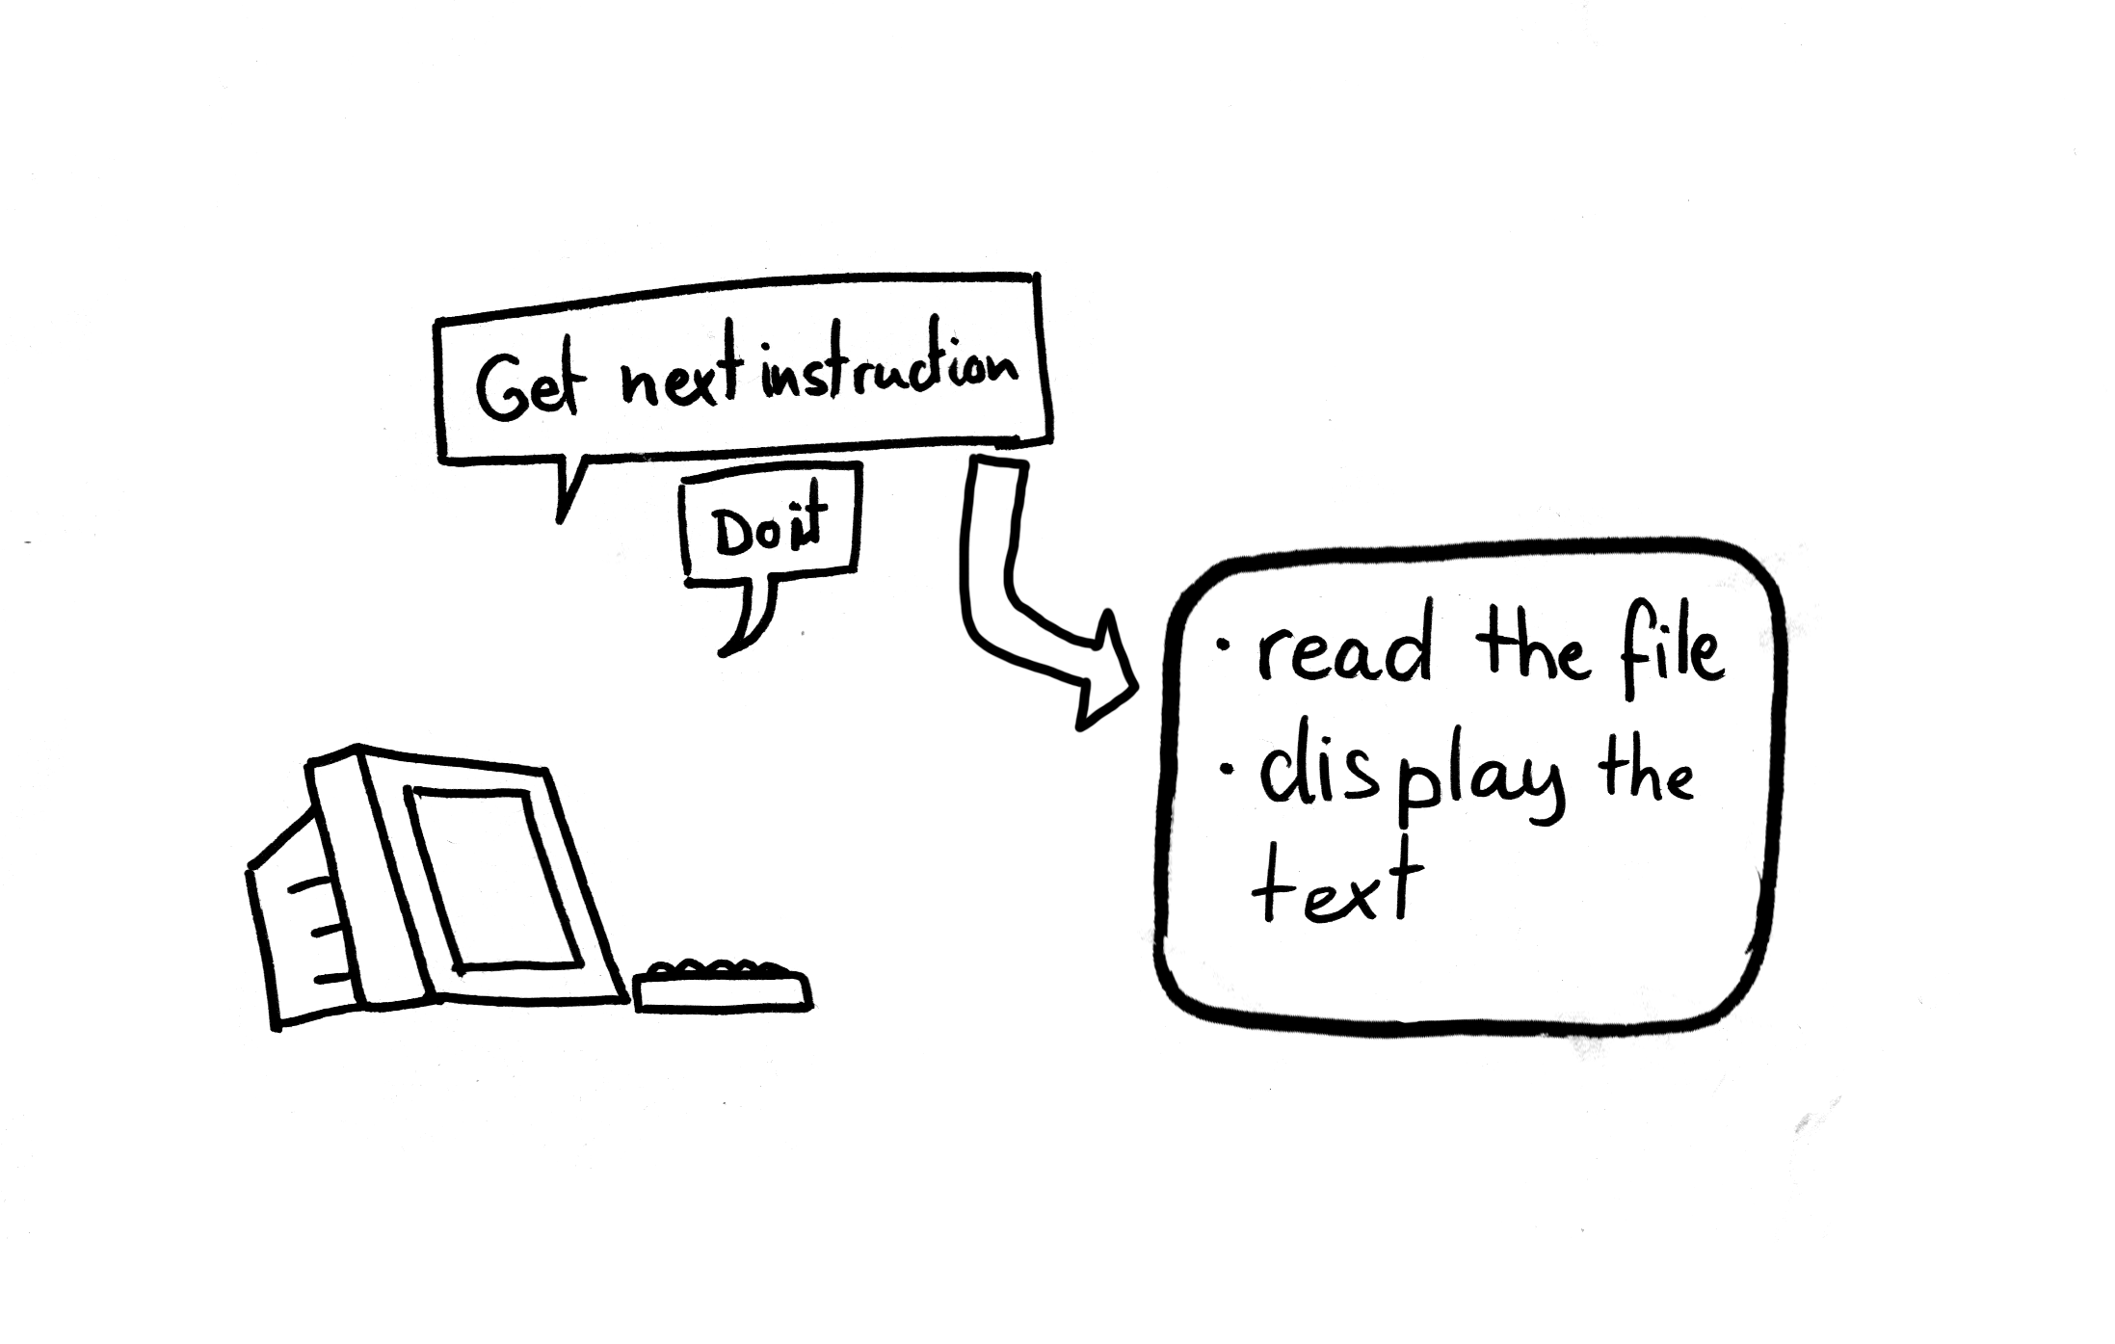

Slide 4
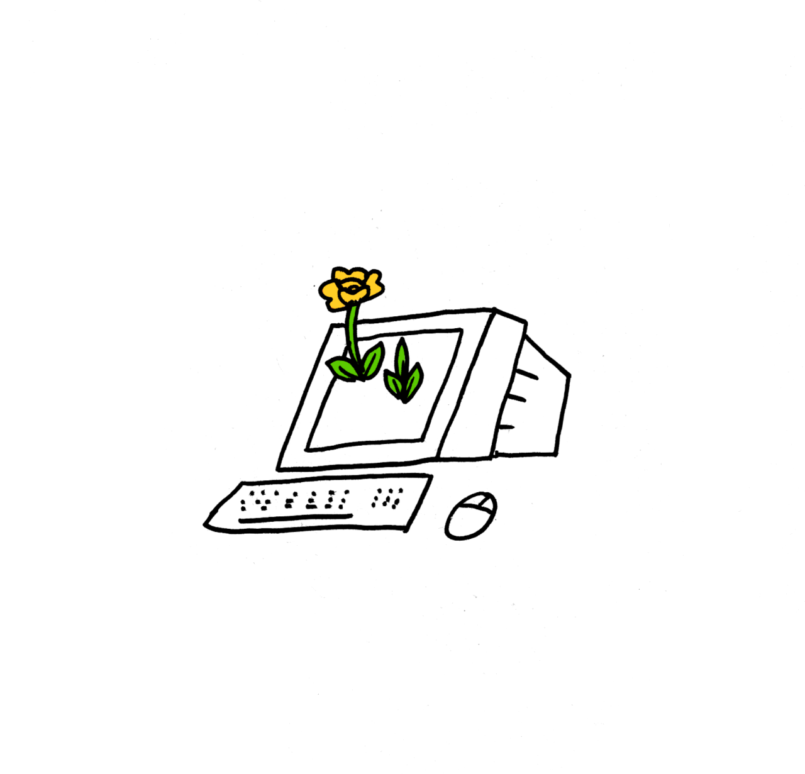
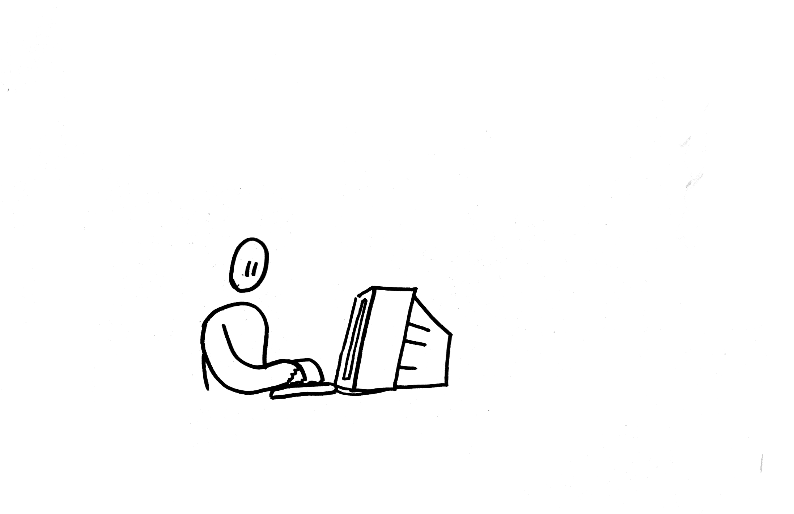

Slide 5
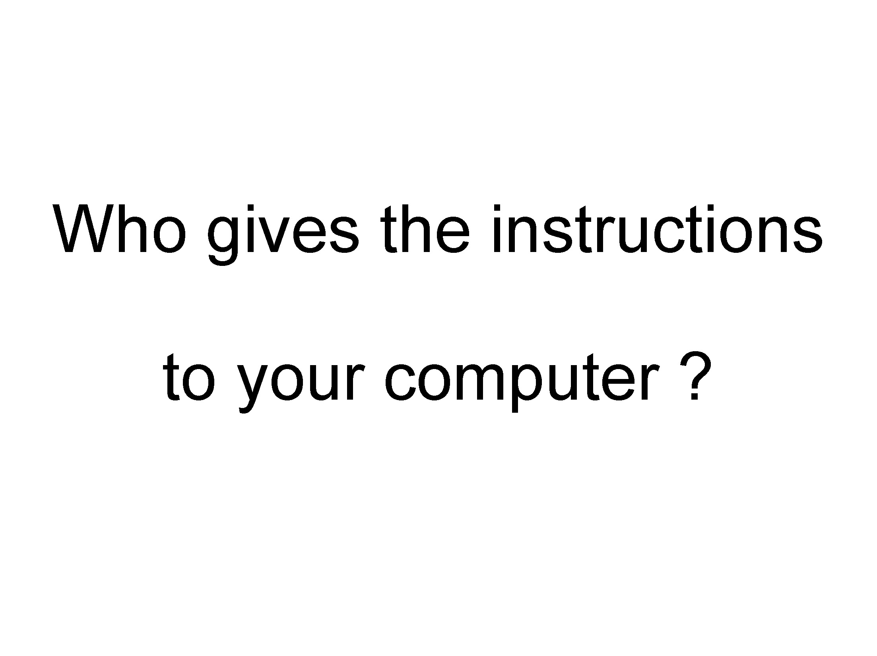

Slide 7
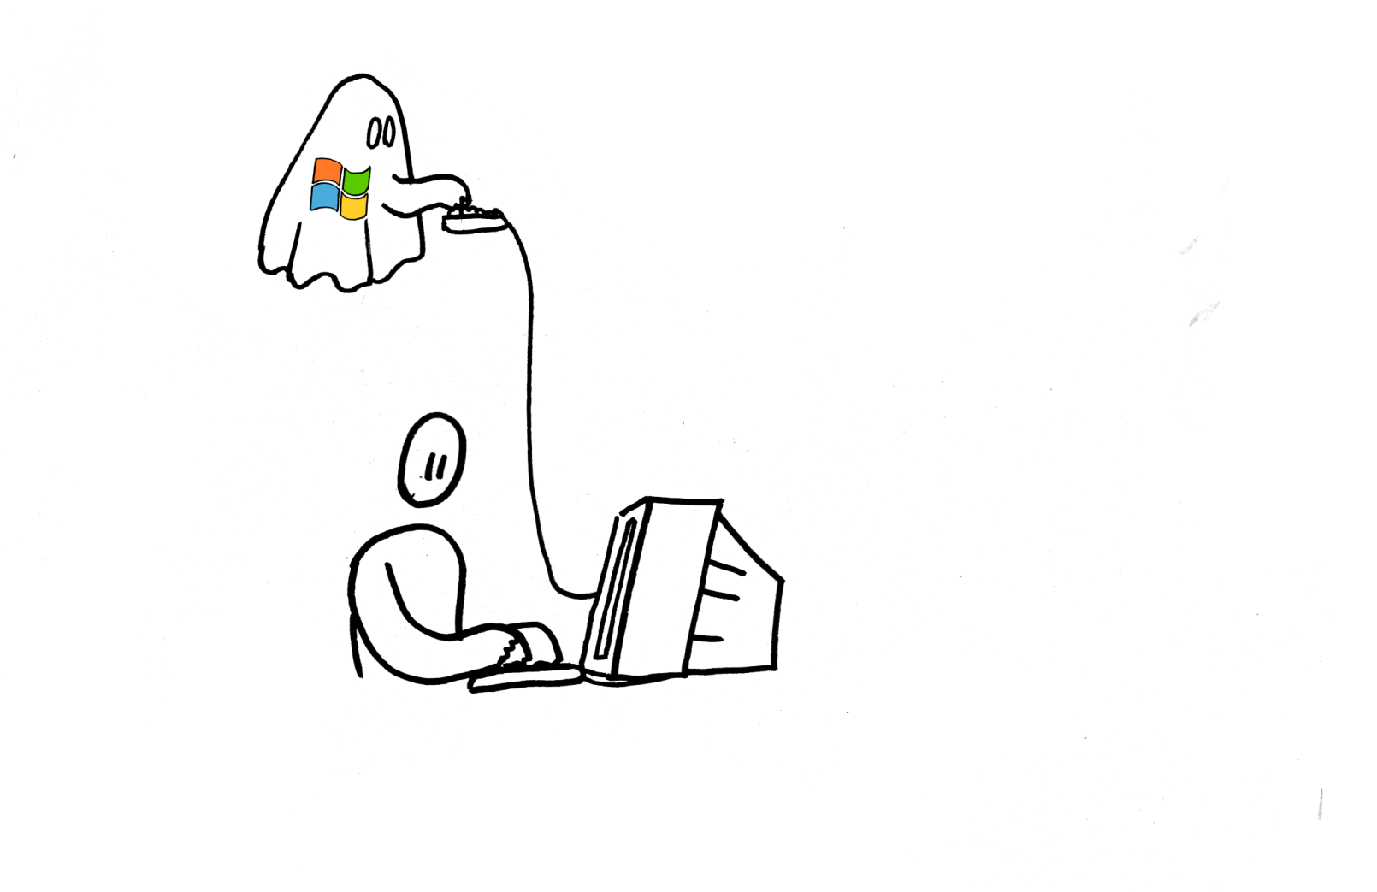

Slide 8
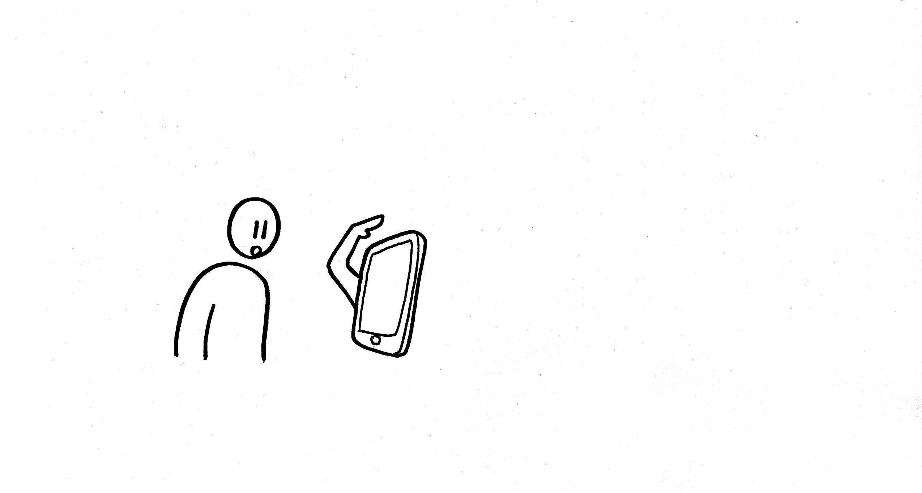

Slide 9
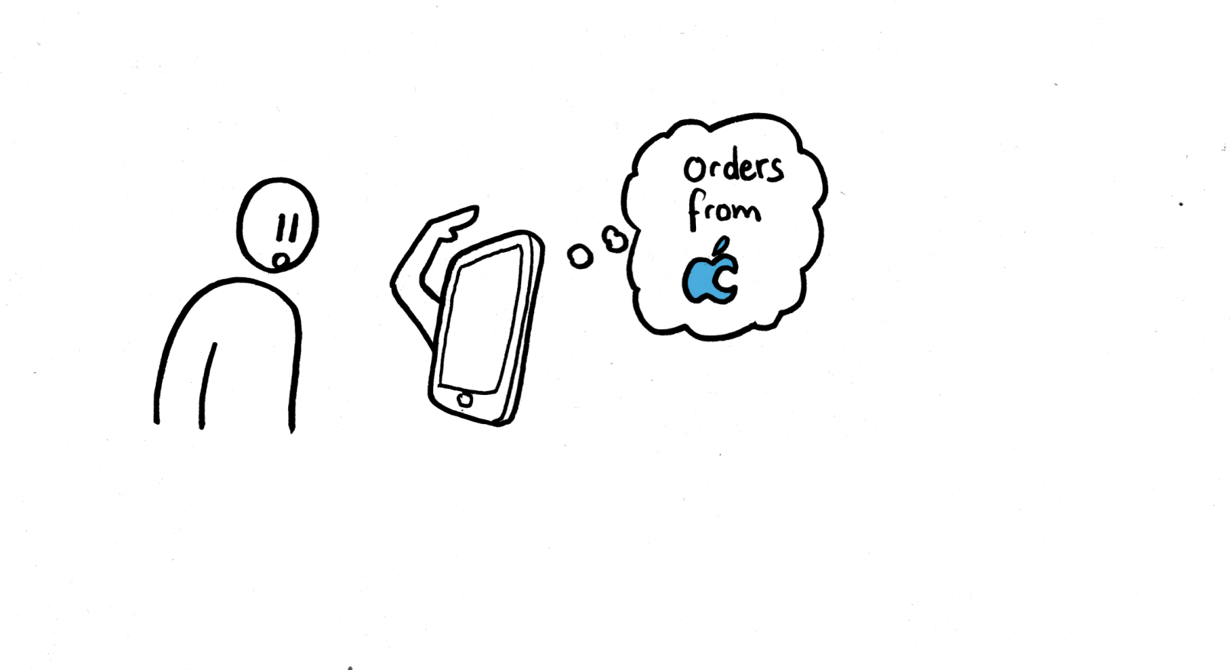
The iMonster's true master

Slide 10
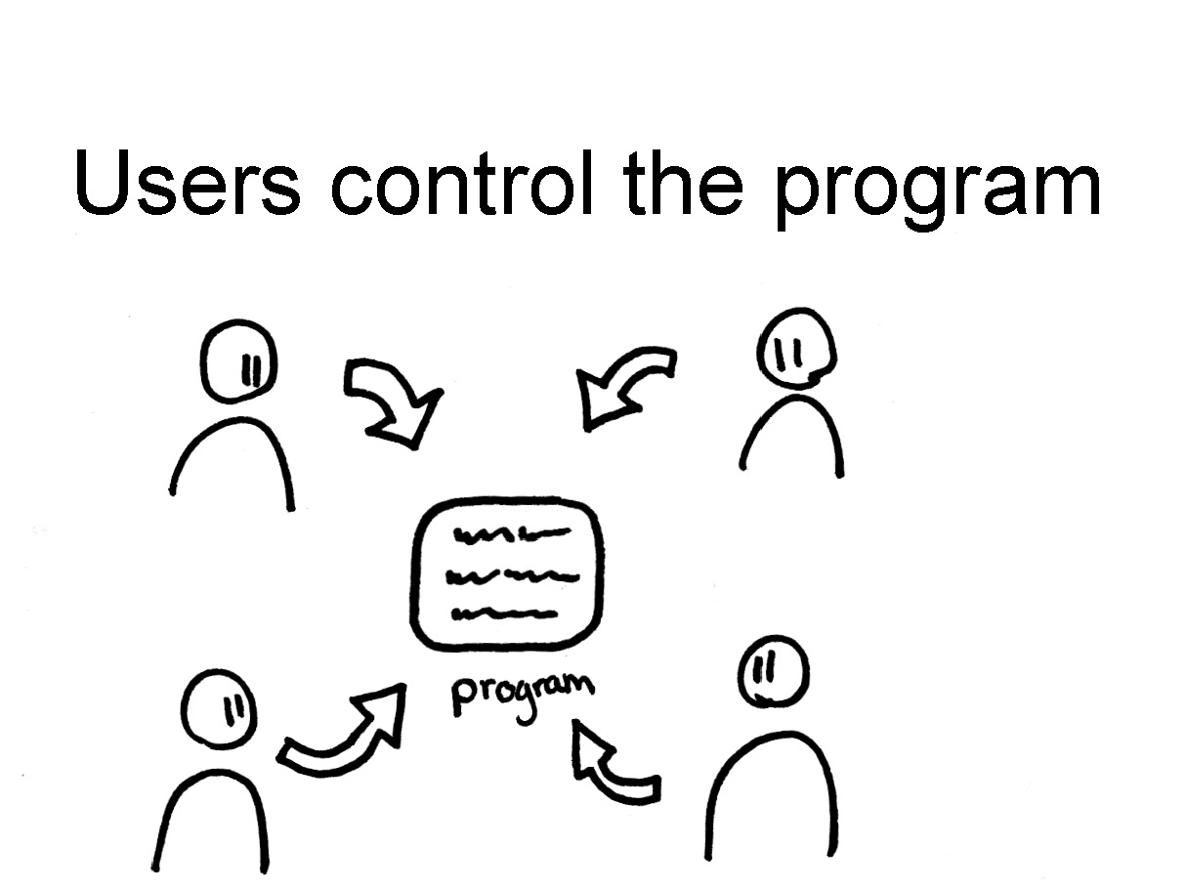

Slide 11
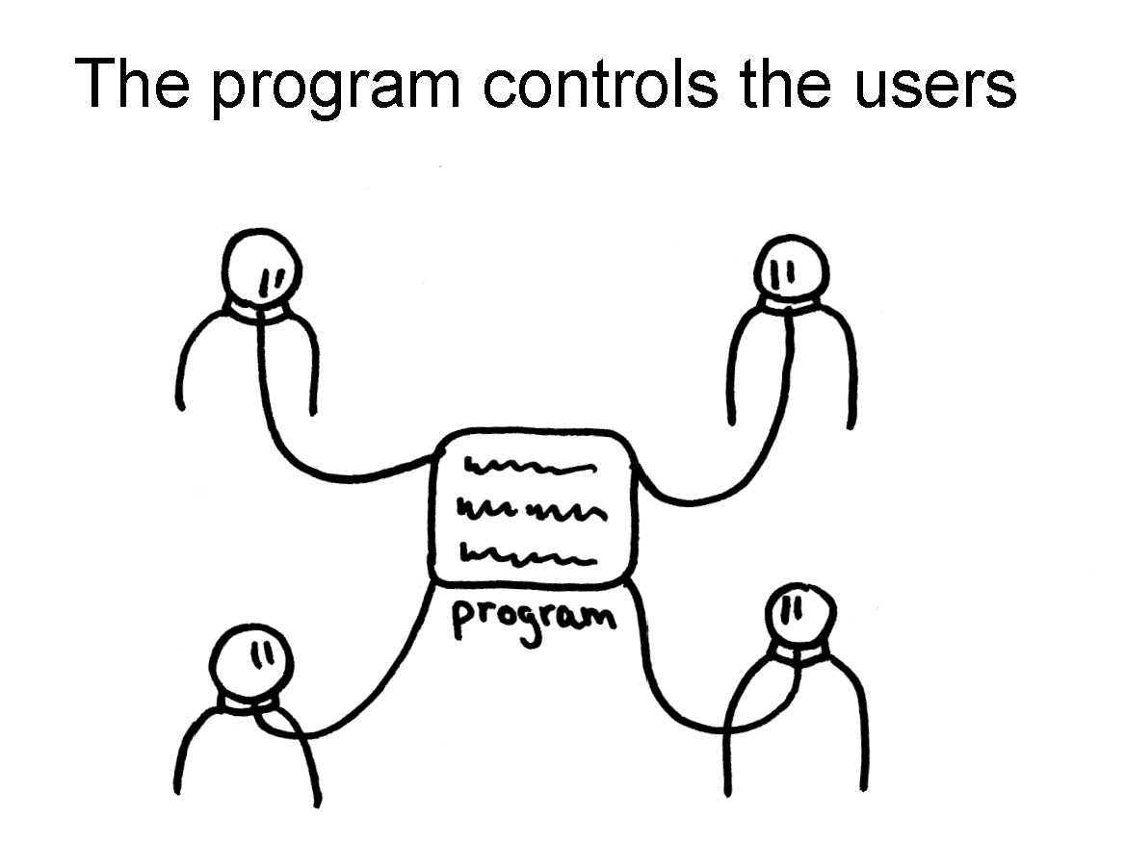

Slide 12
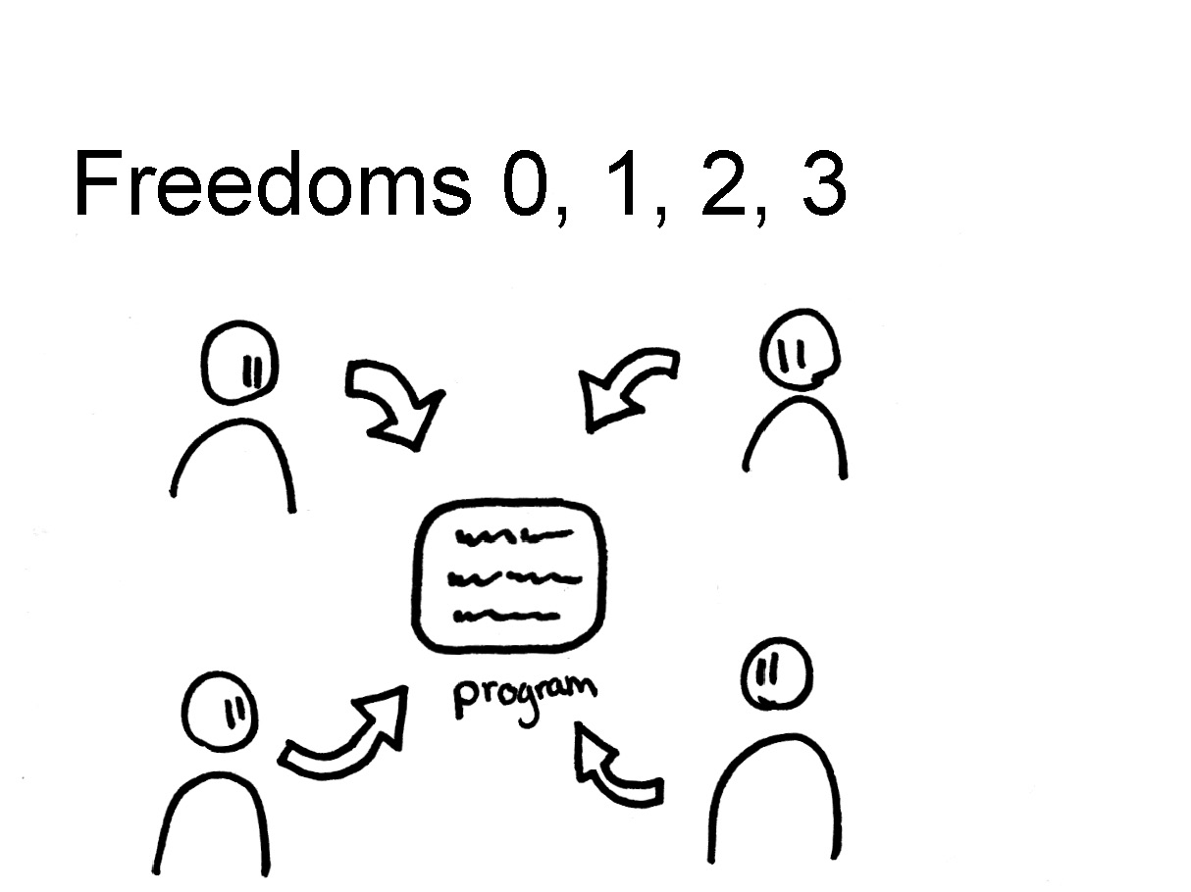

Slide 13
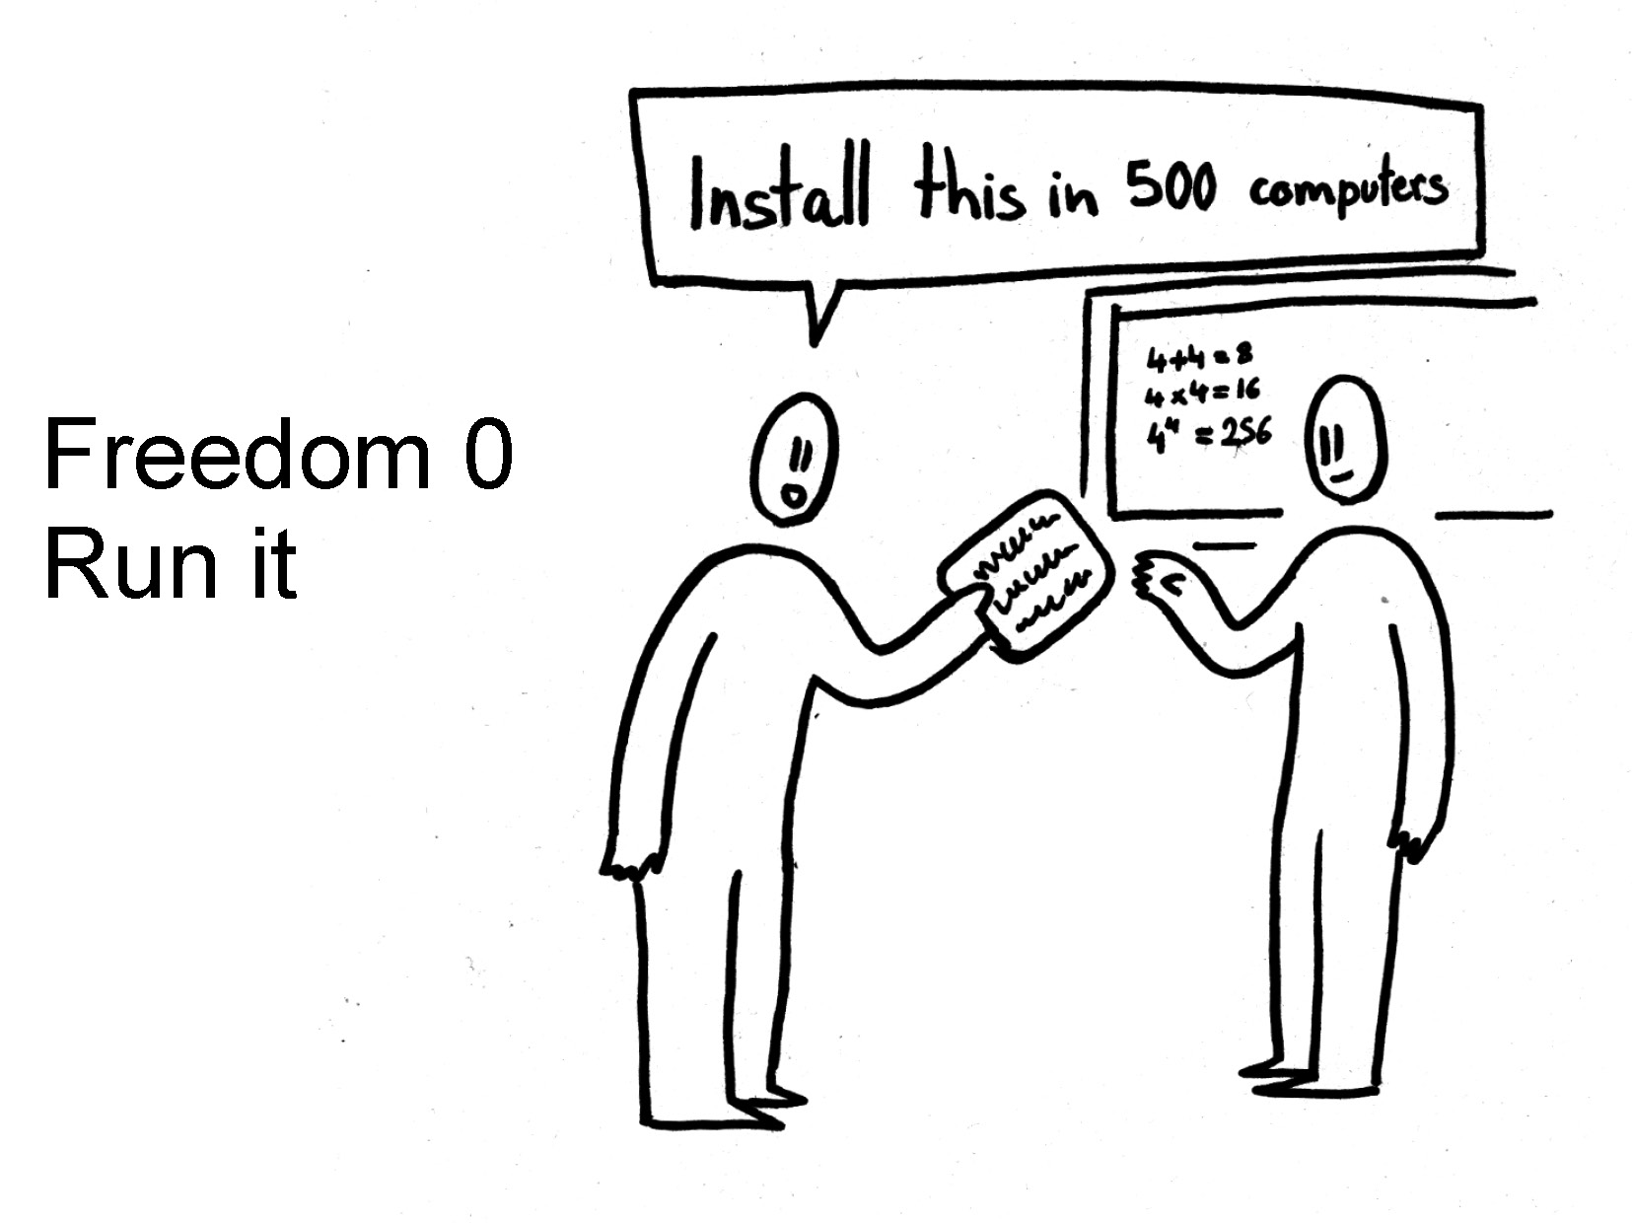

Slide 14
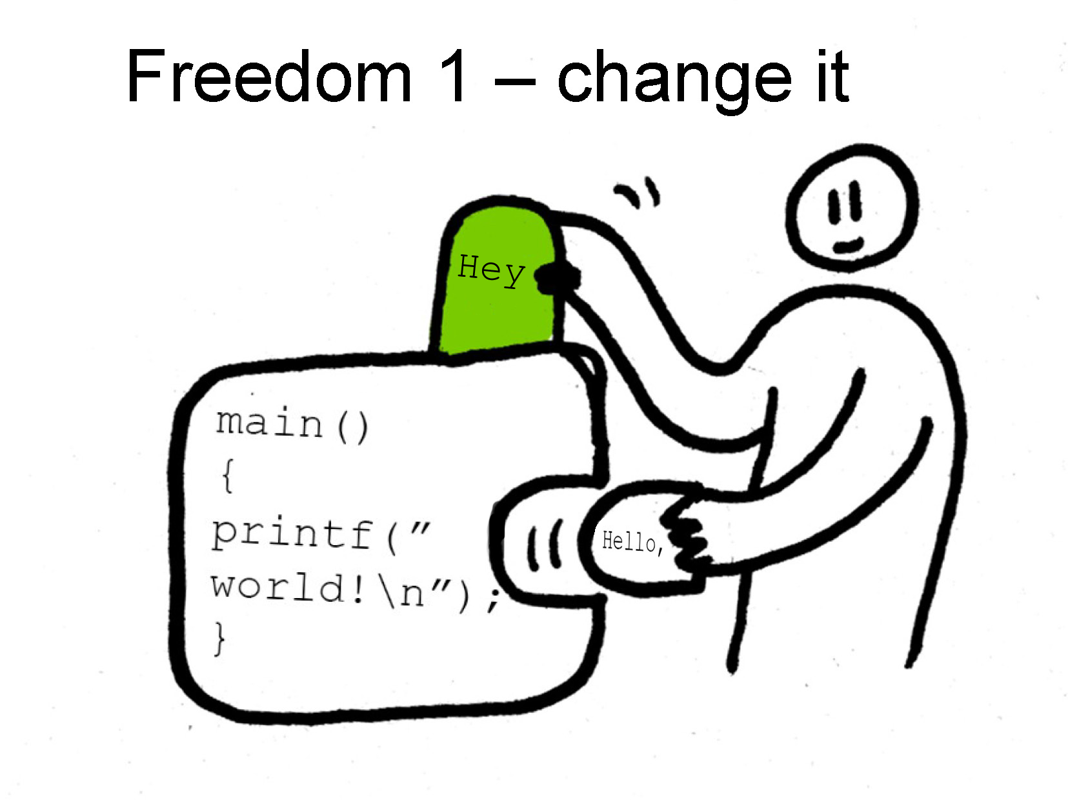

Slide 15
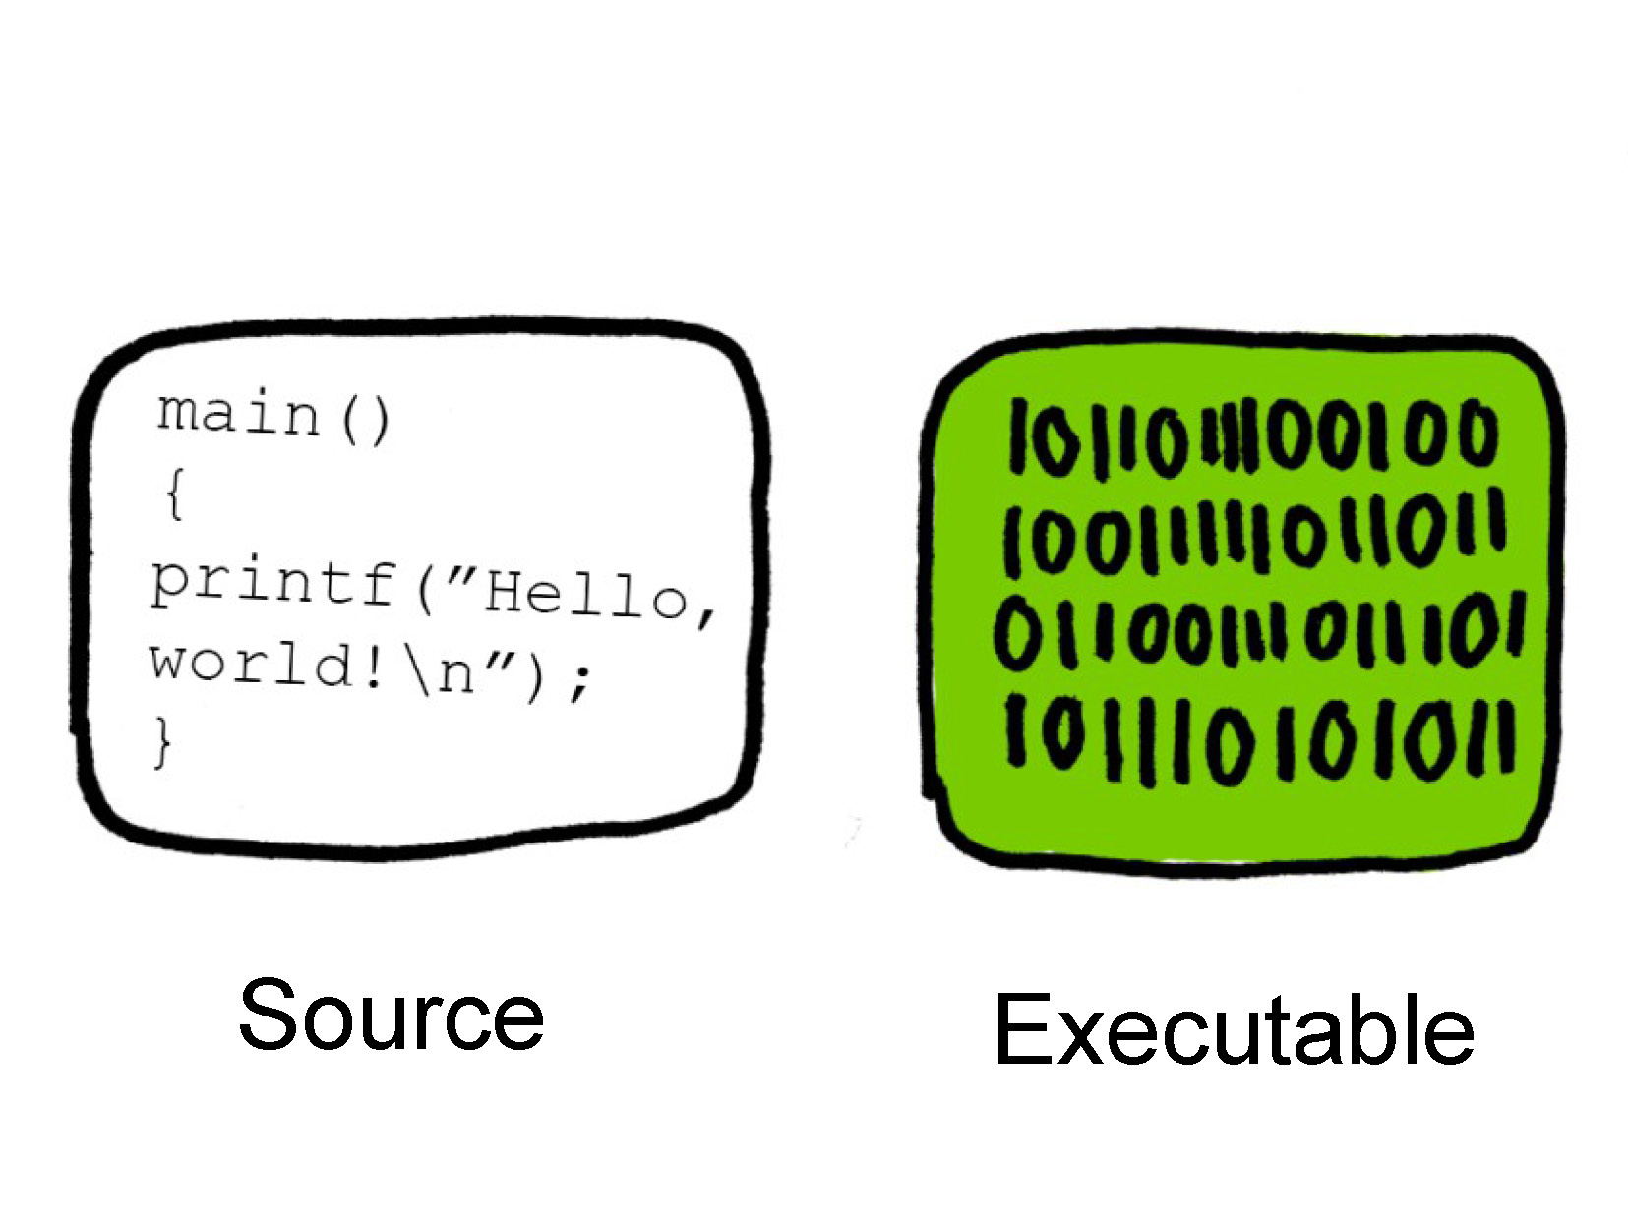

Slide 16
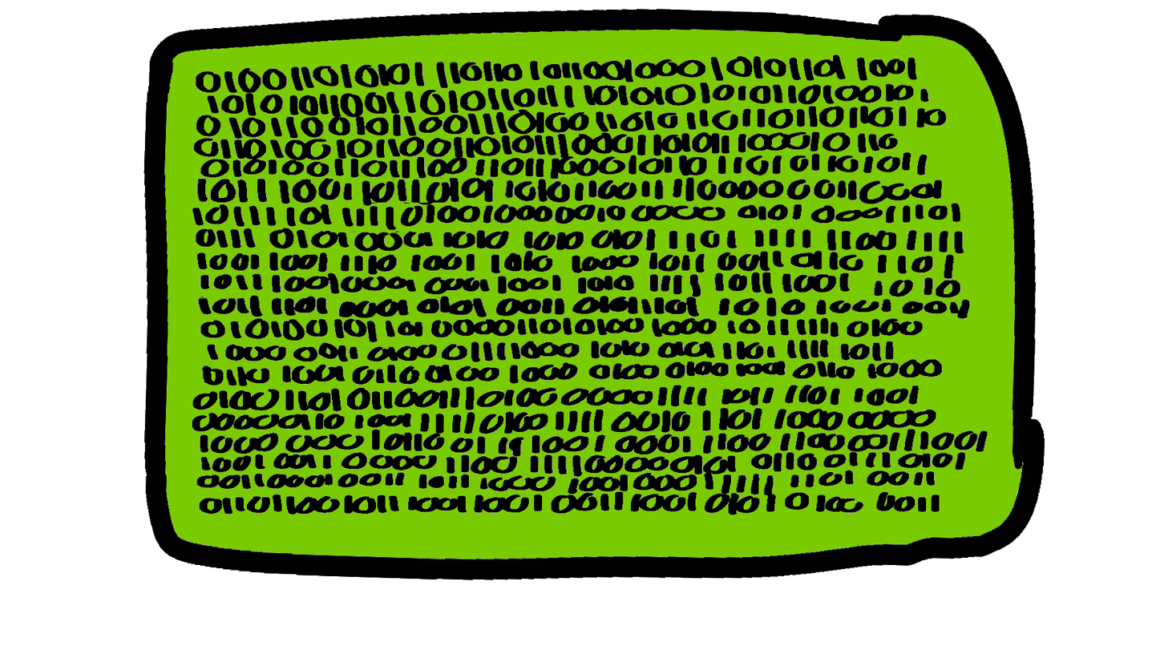
Can you figure it out?

Slide 17
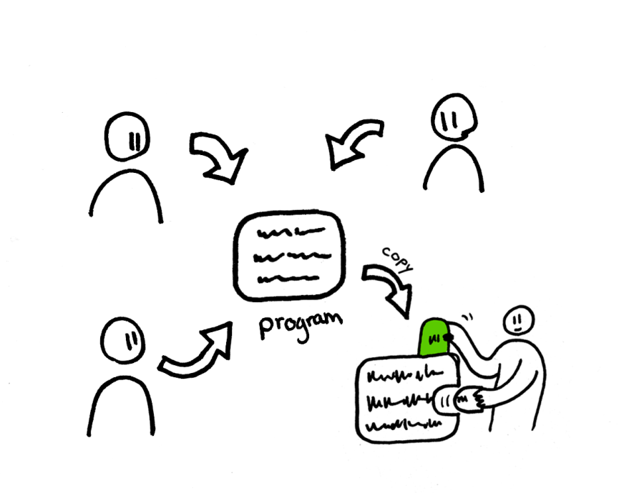

Slide 18
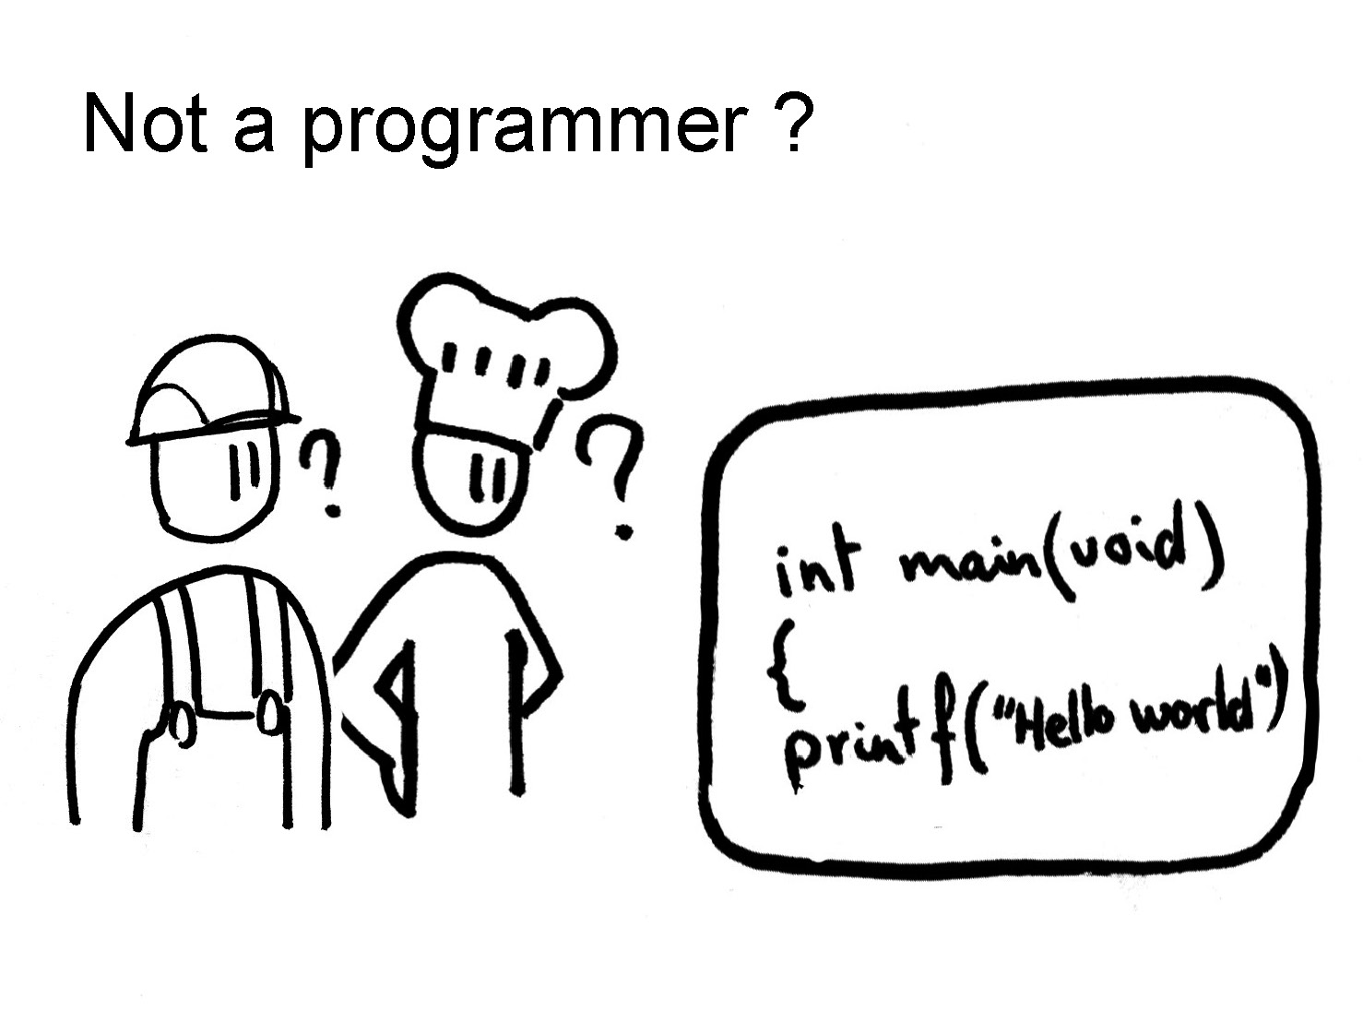

Slide 19
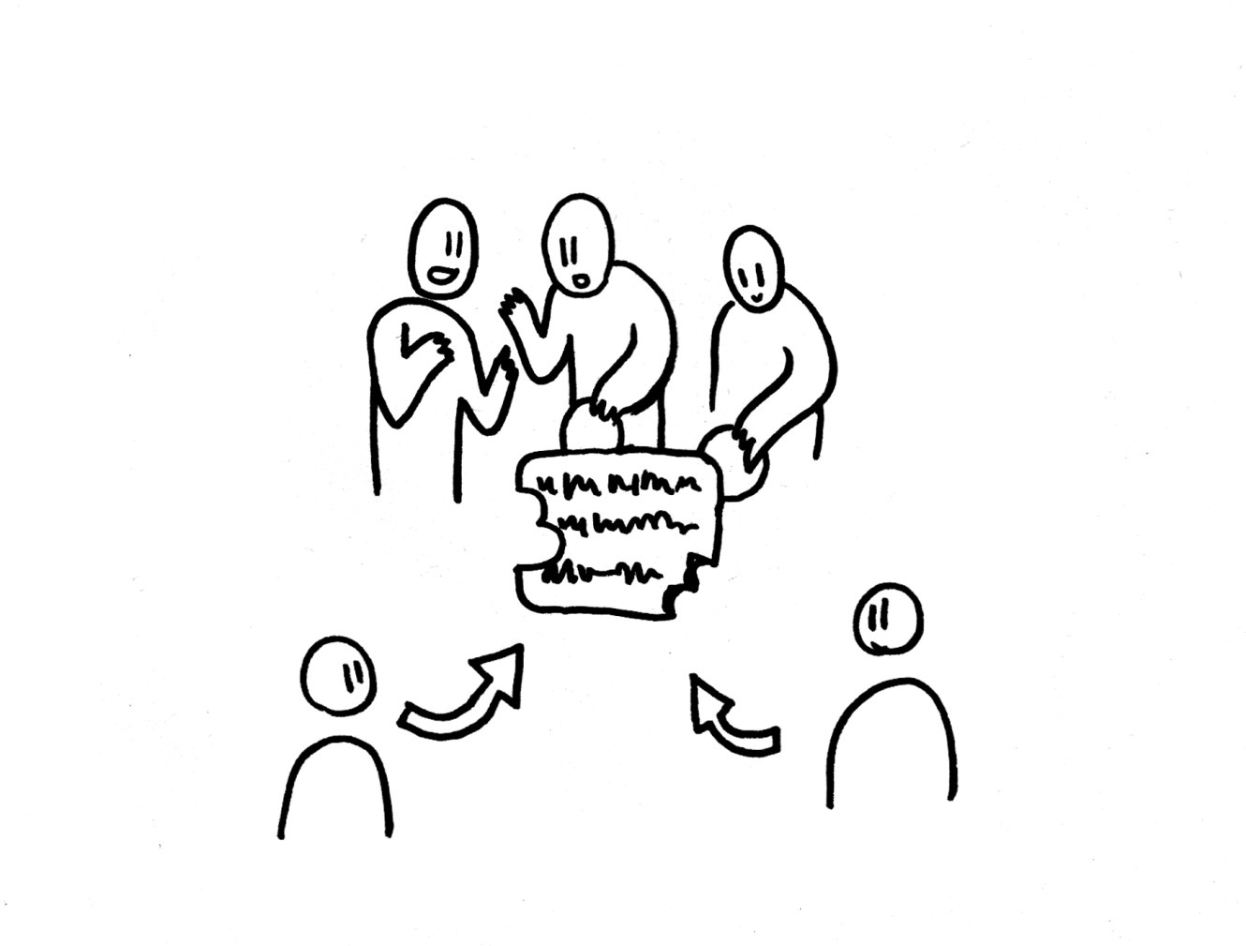

Slide 20
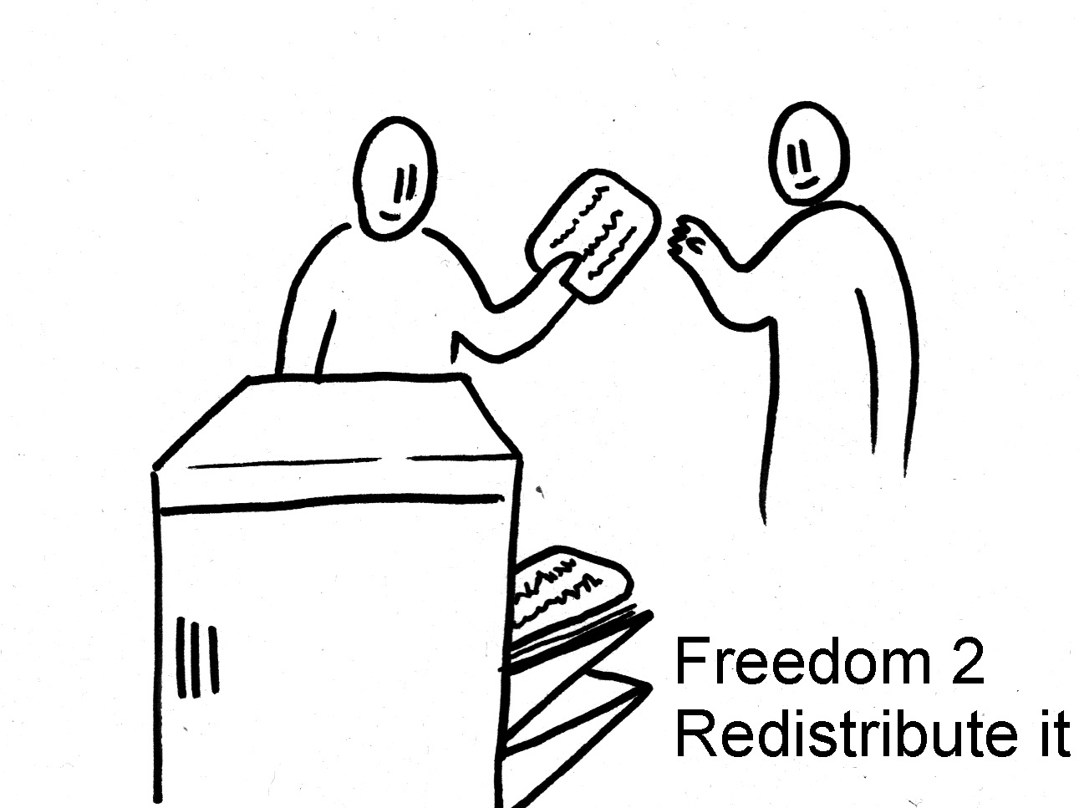

Slide 21
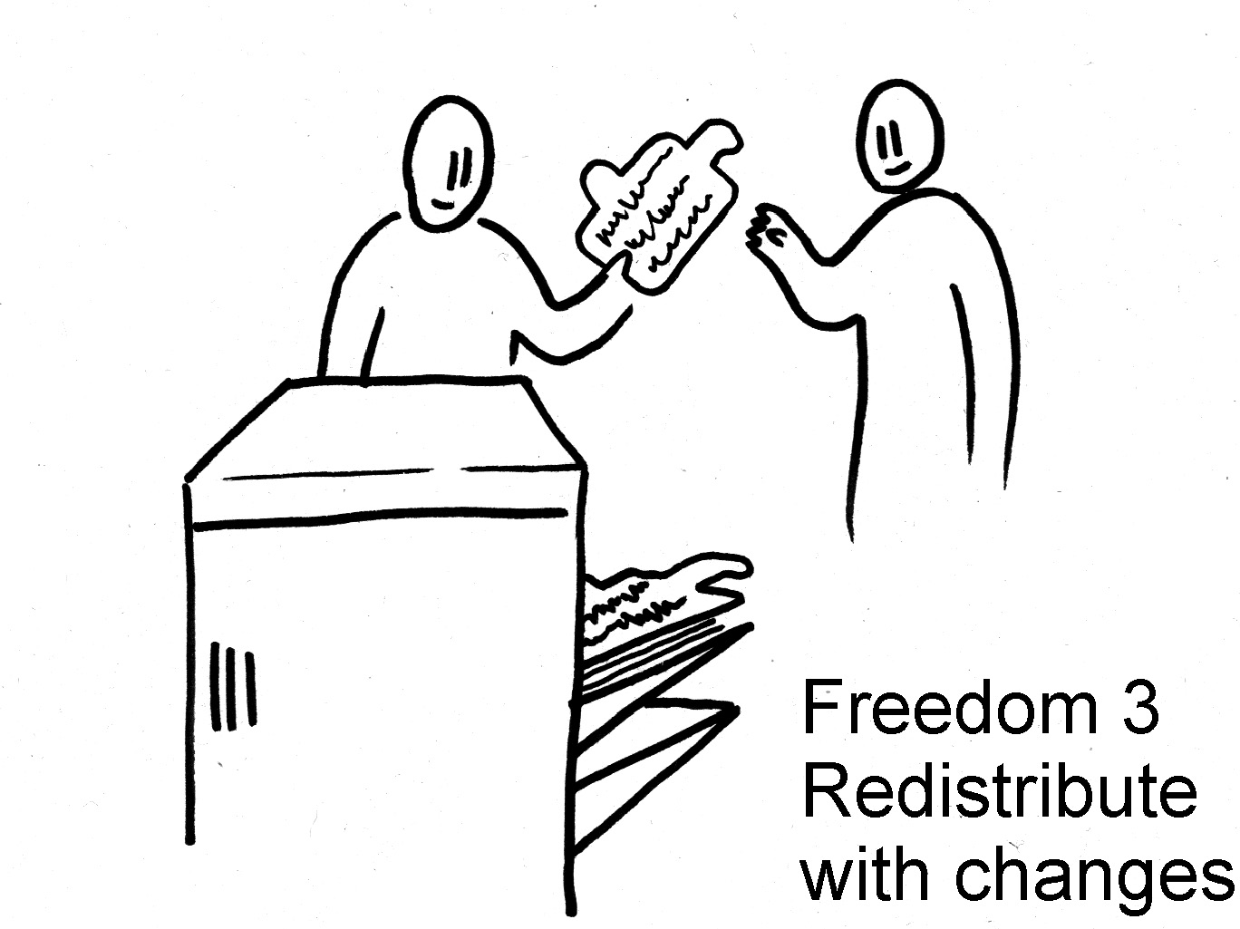

Slide 22
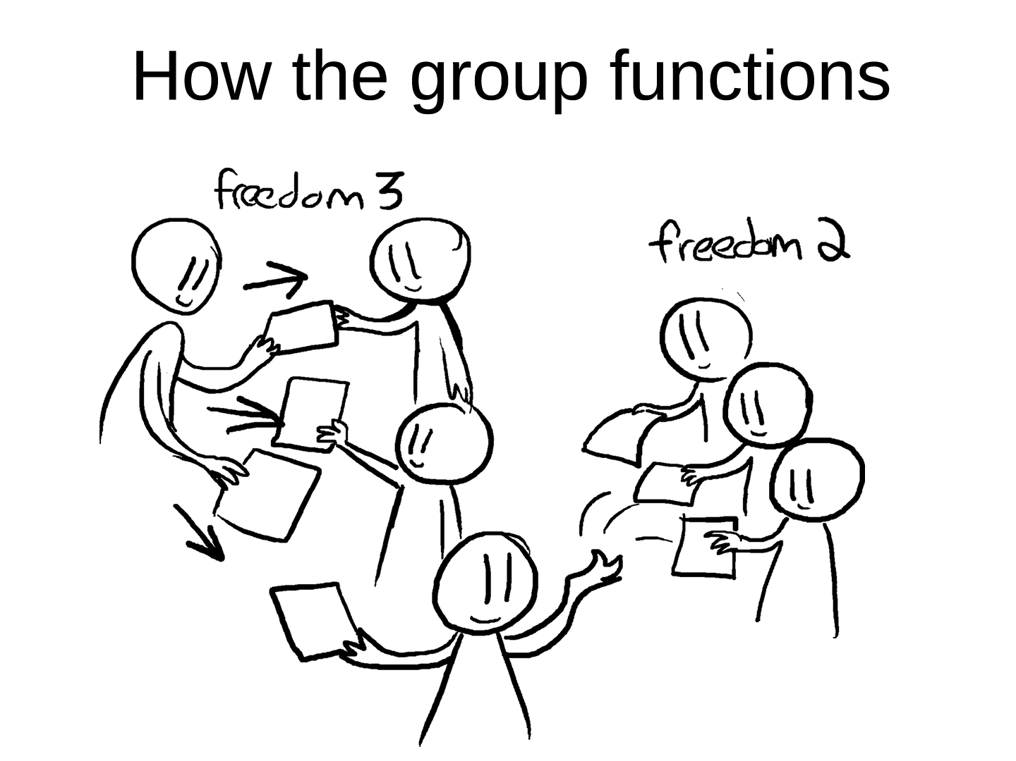

Slide 23
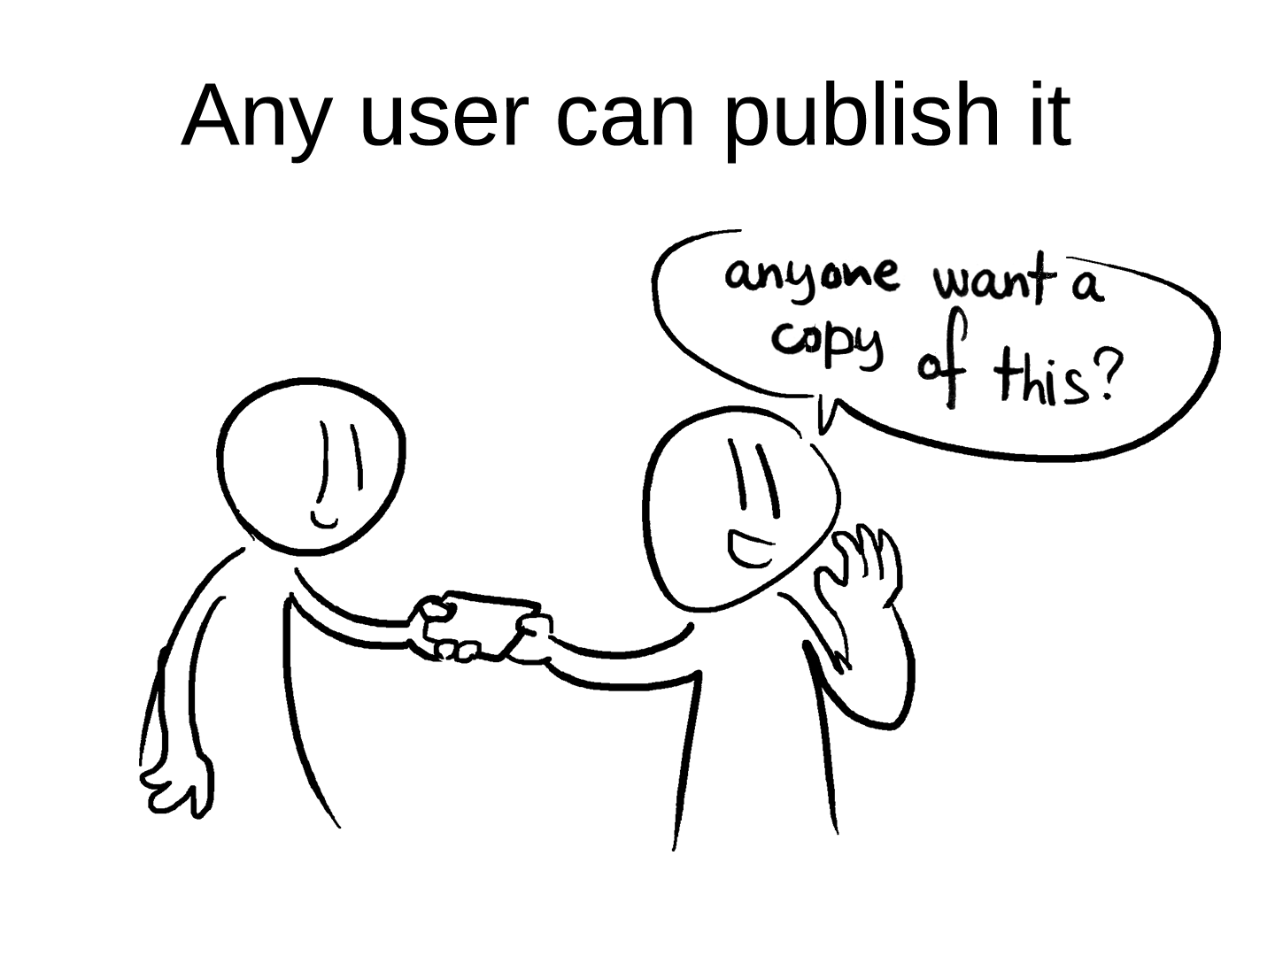

Slide 25
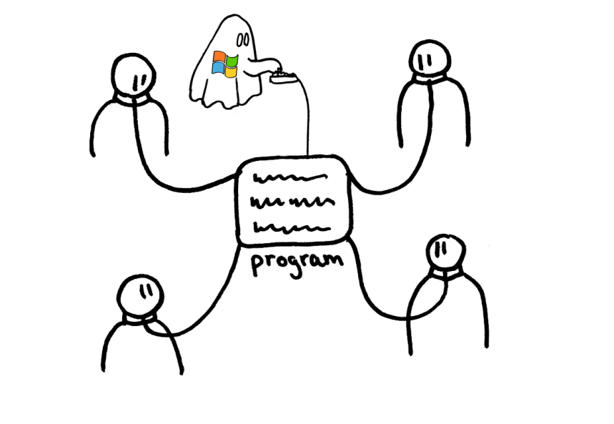

Slide 26
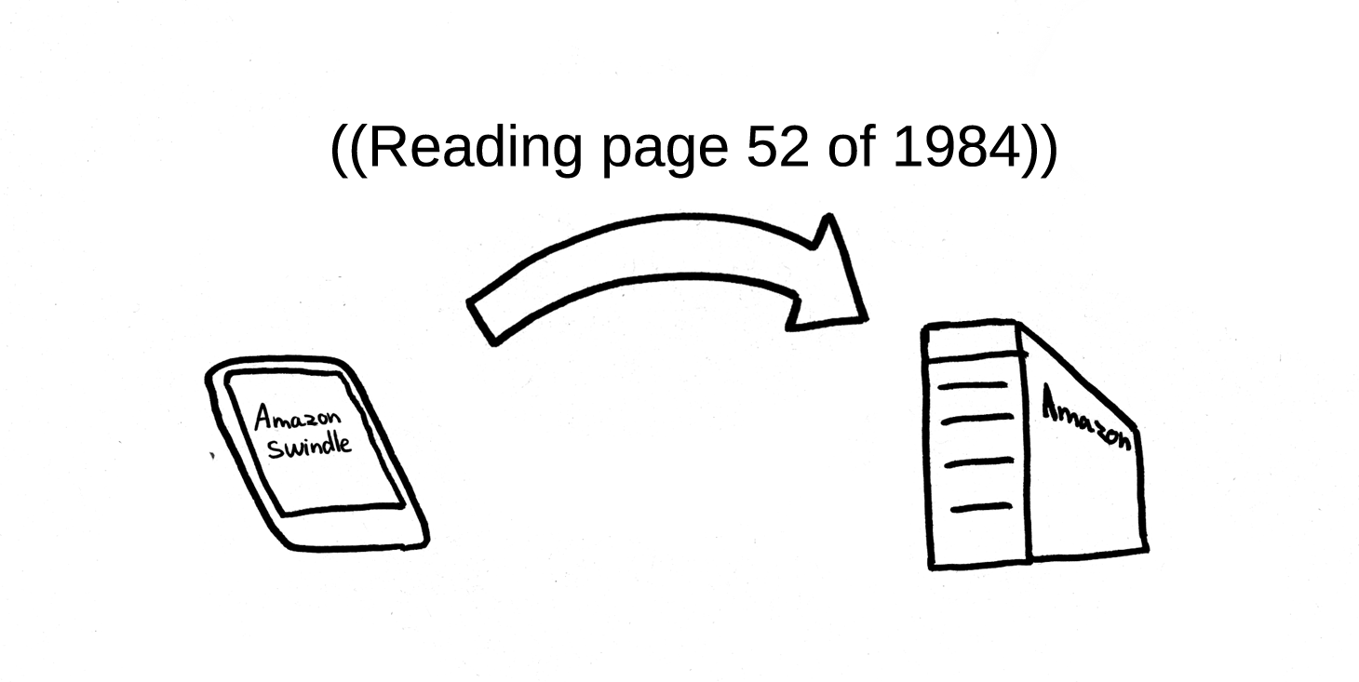
Amazon Swindle Snooping

Slide 27
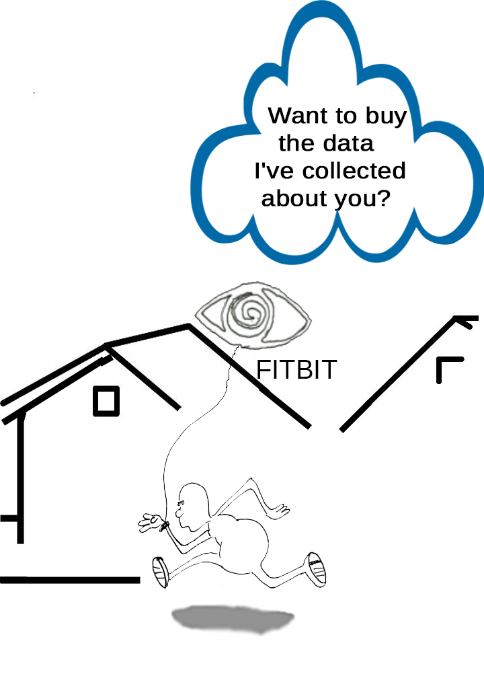

Slide 28
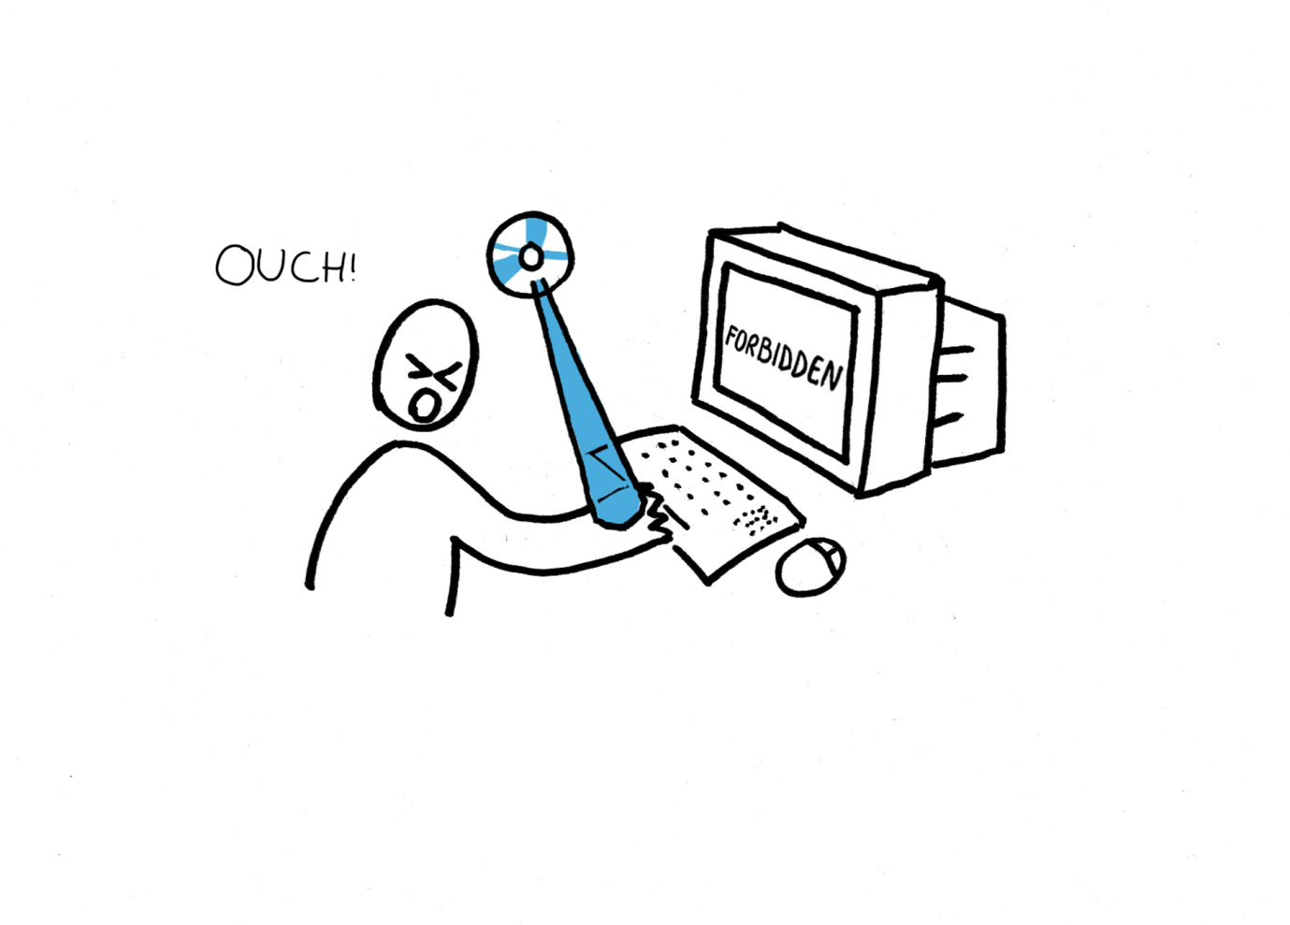
Infamous Blue Ray

Slide 29
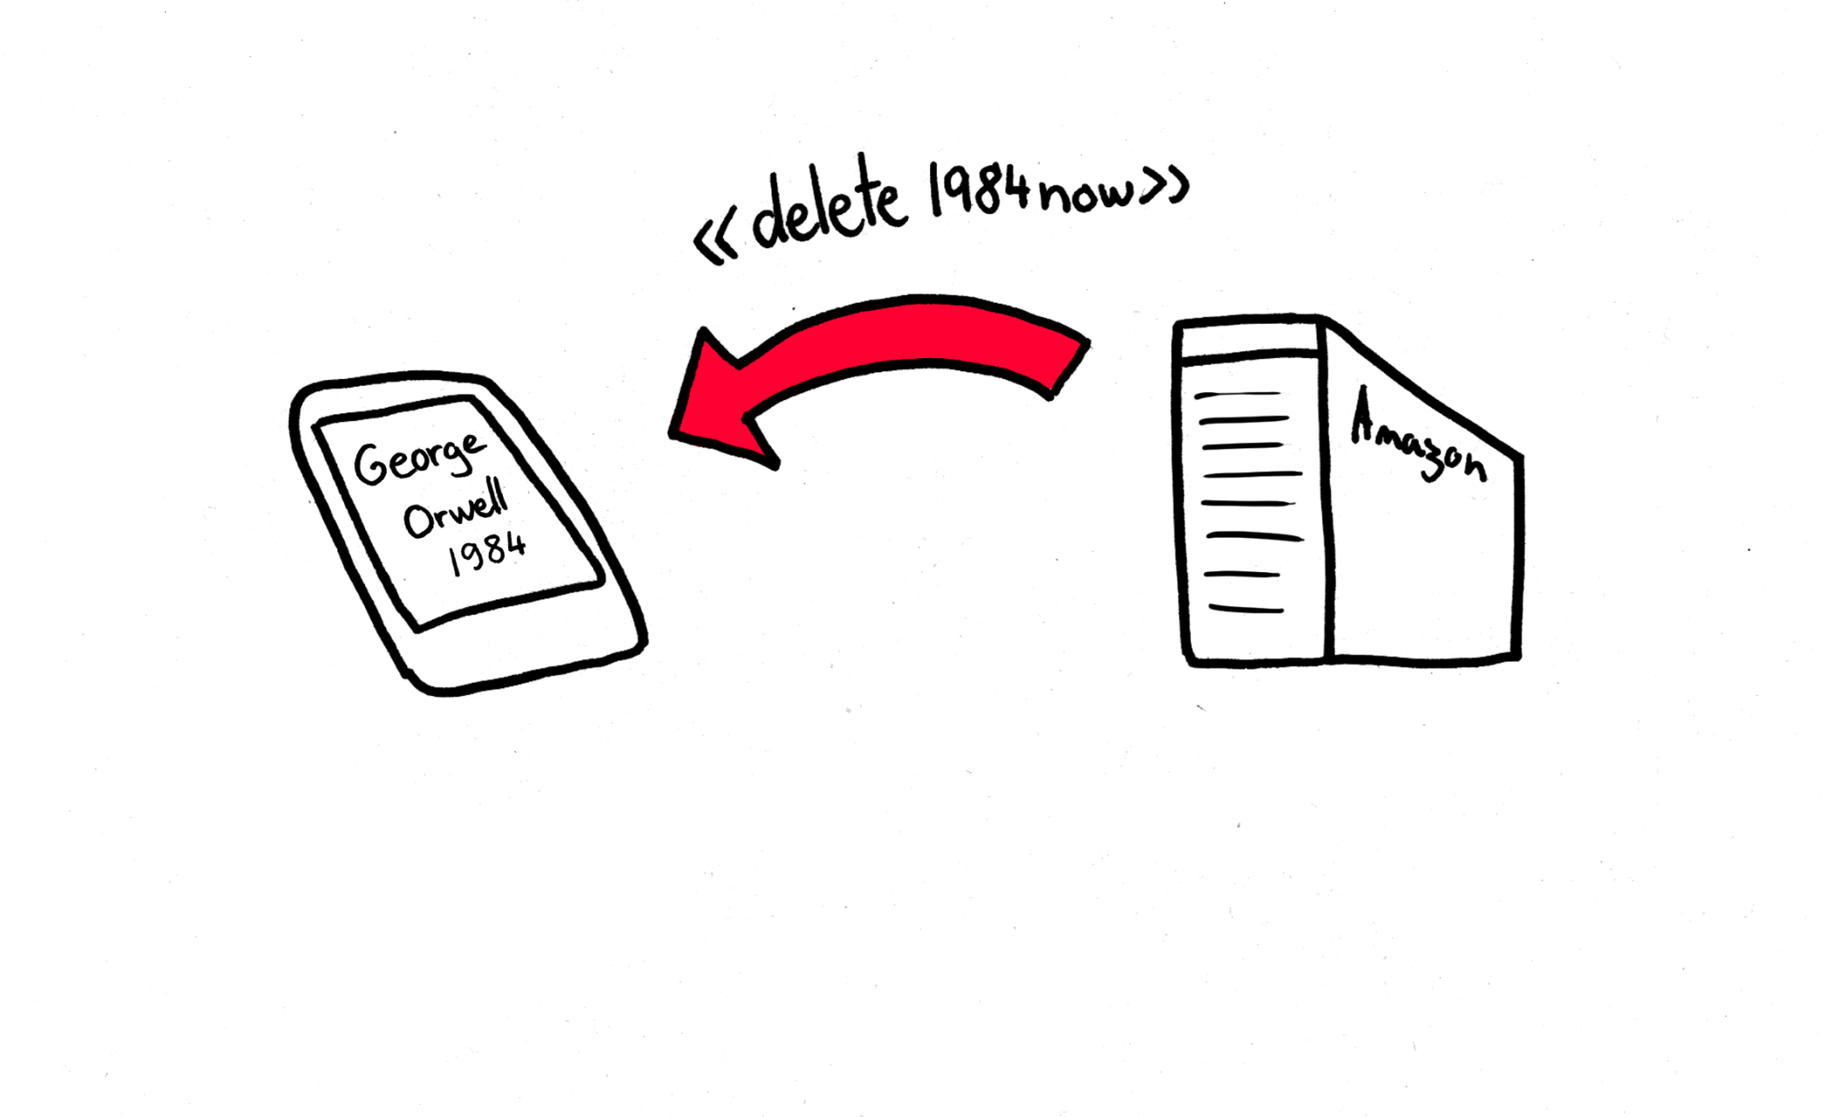
Remote erasure of books

Slide 30
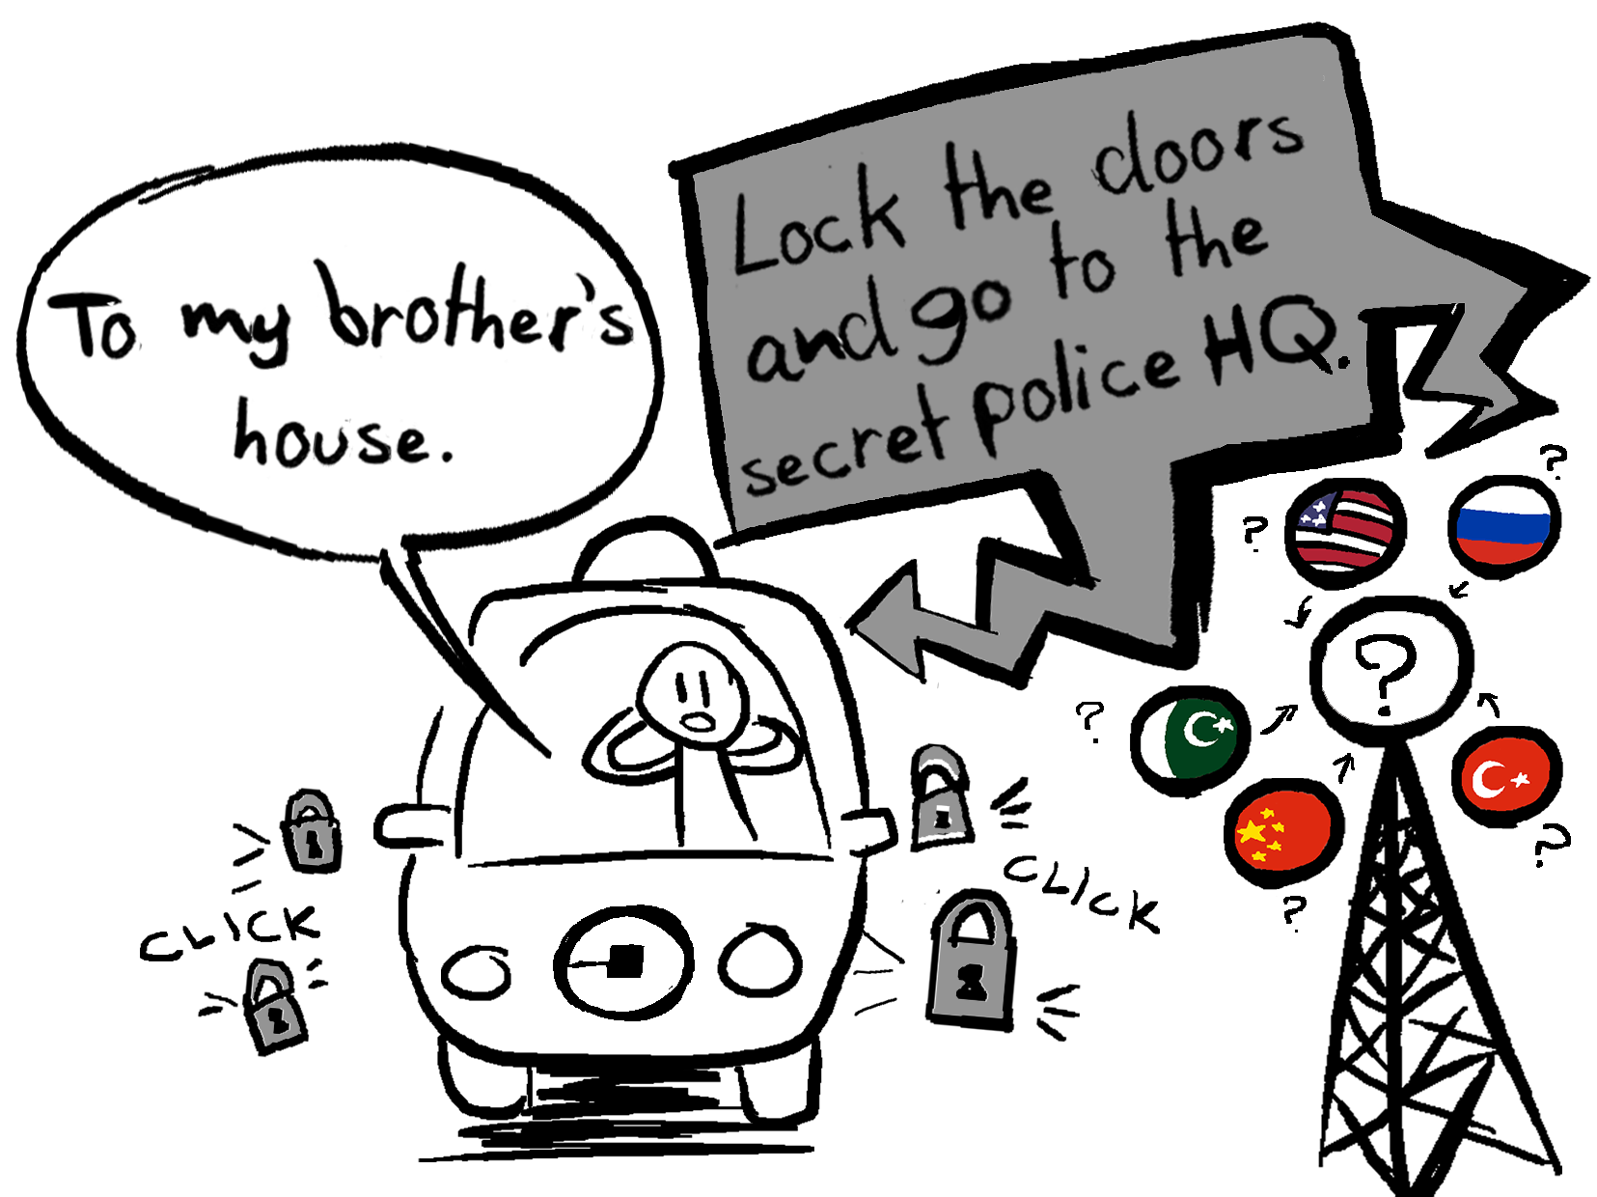

Slide 31
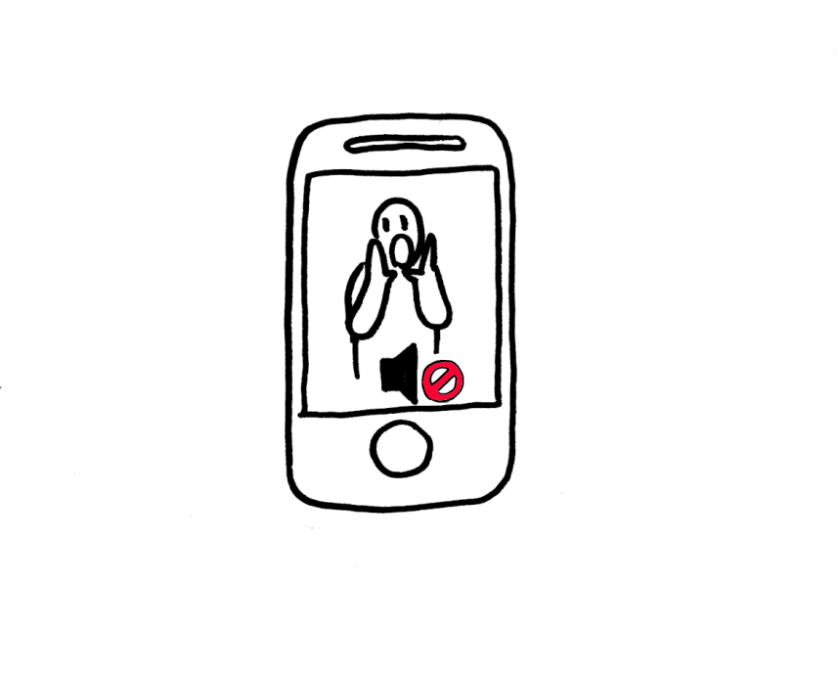
Censorship in Apple's Jail

Slide 32
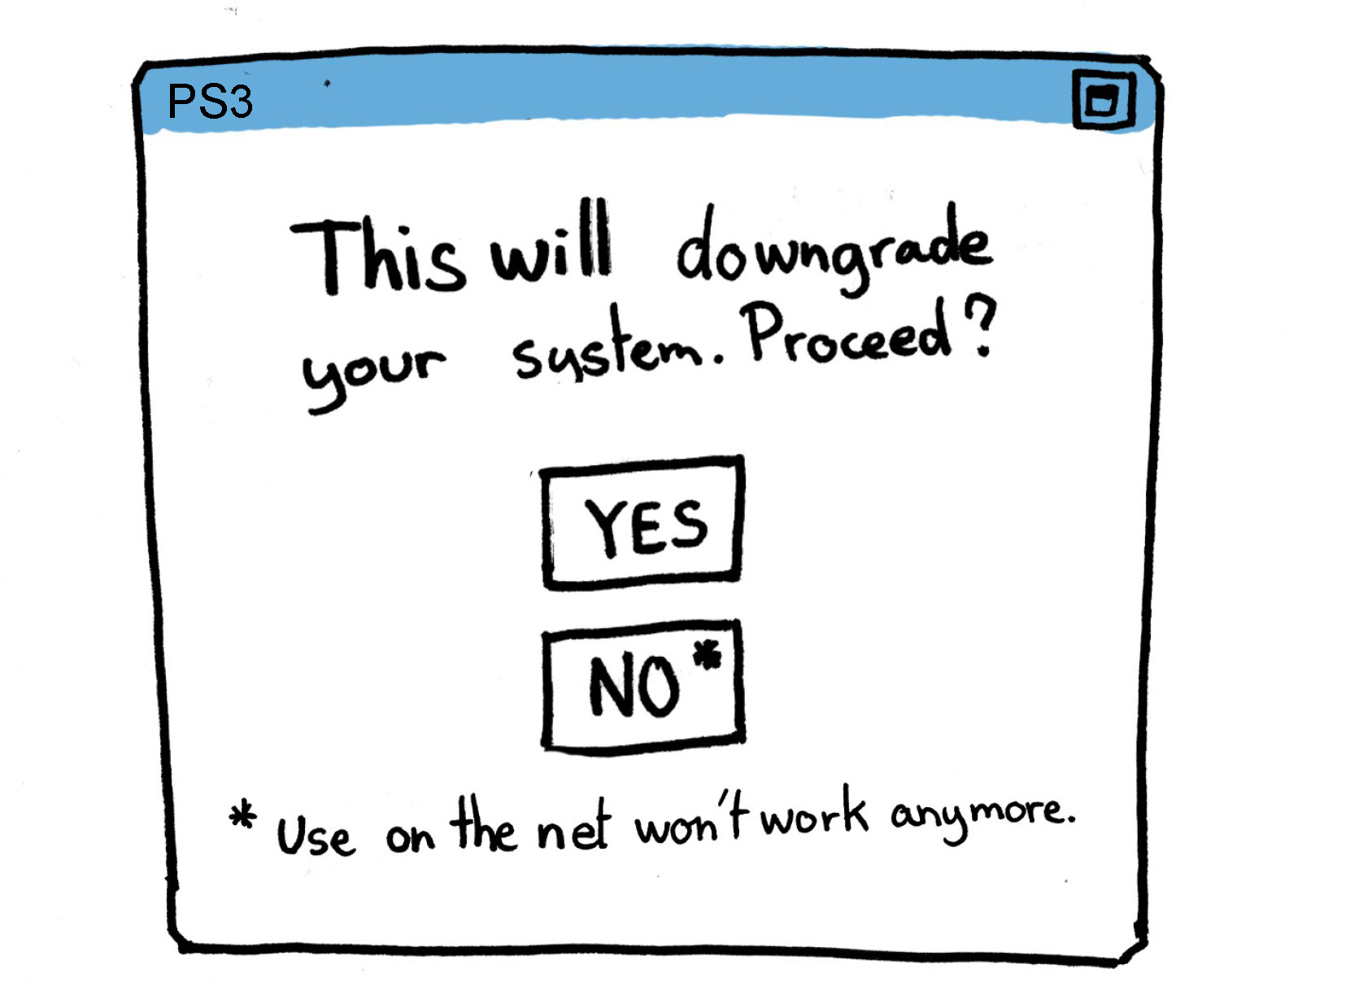

Slide 33
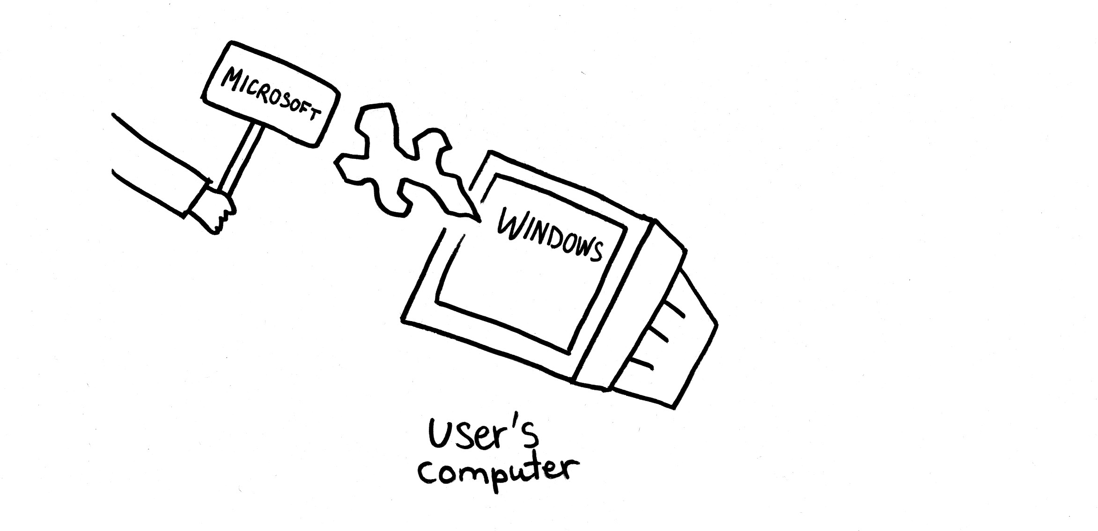
Universal Back Door

Slide 34
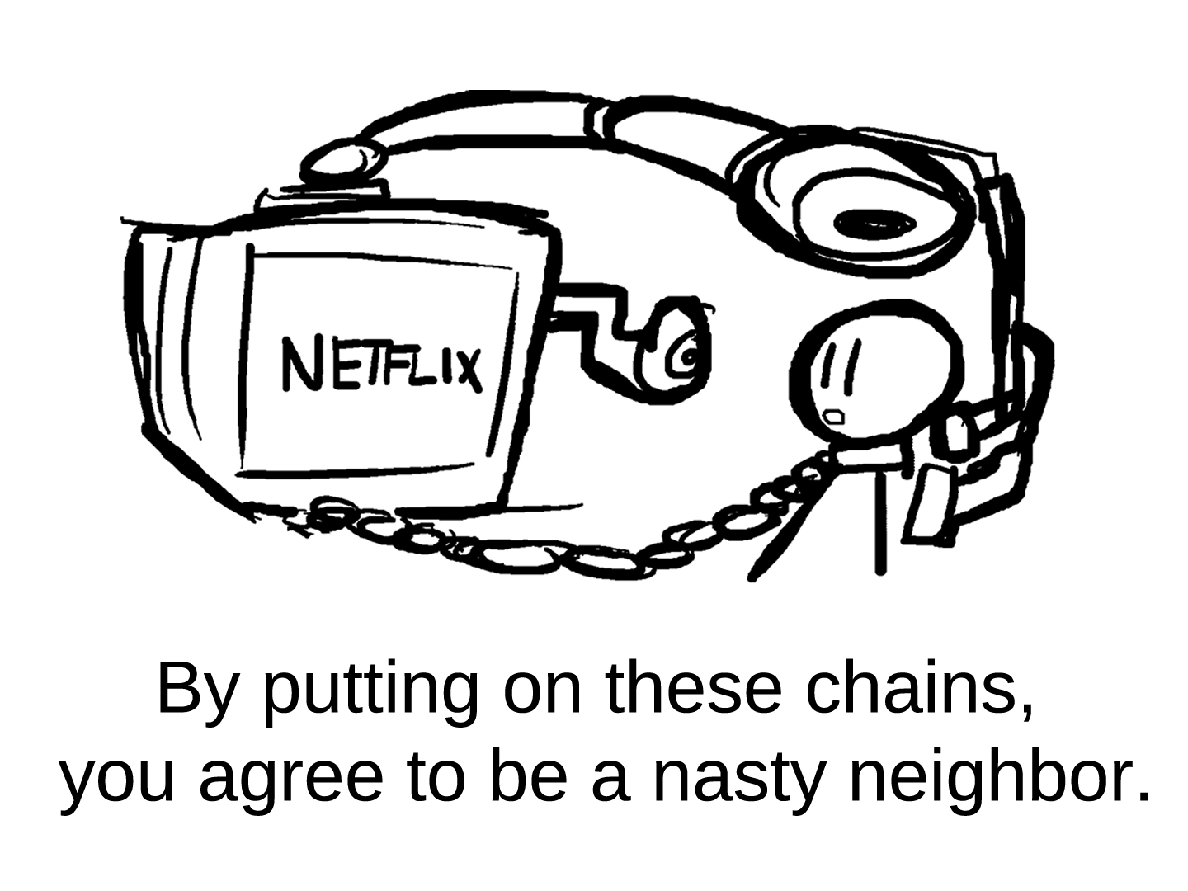

Slide 35
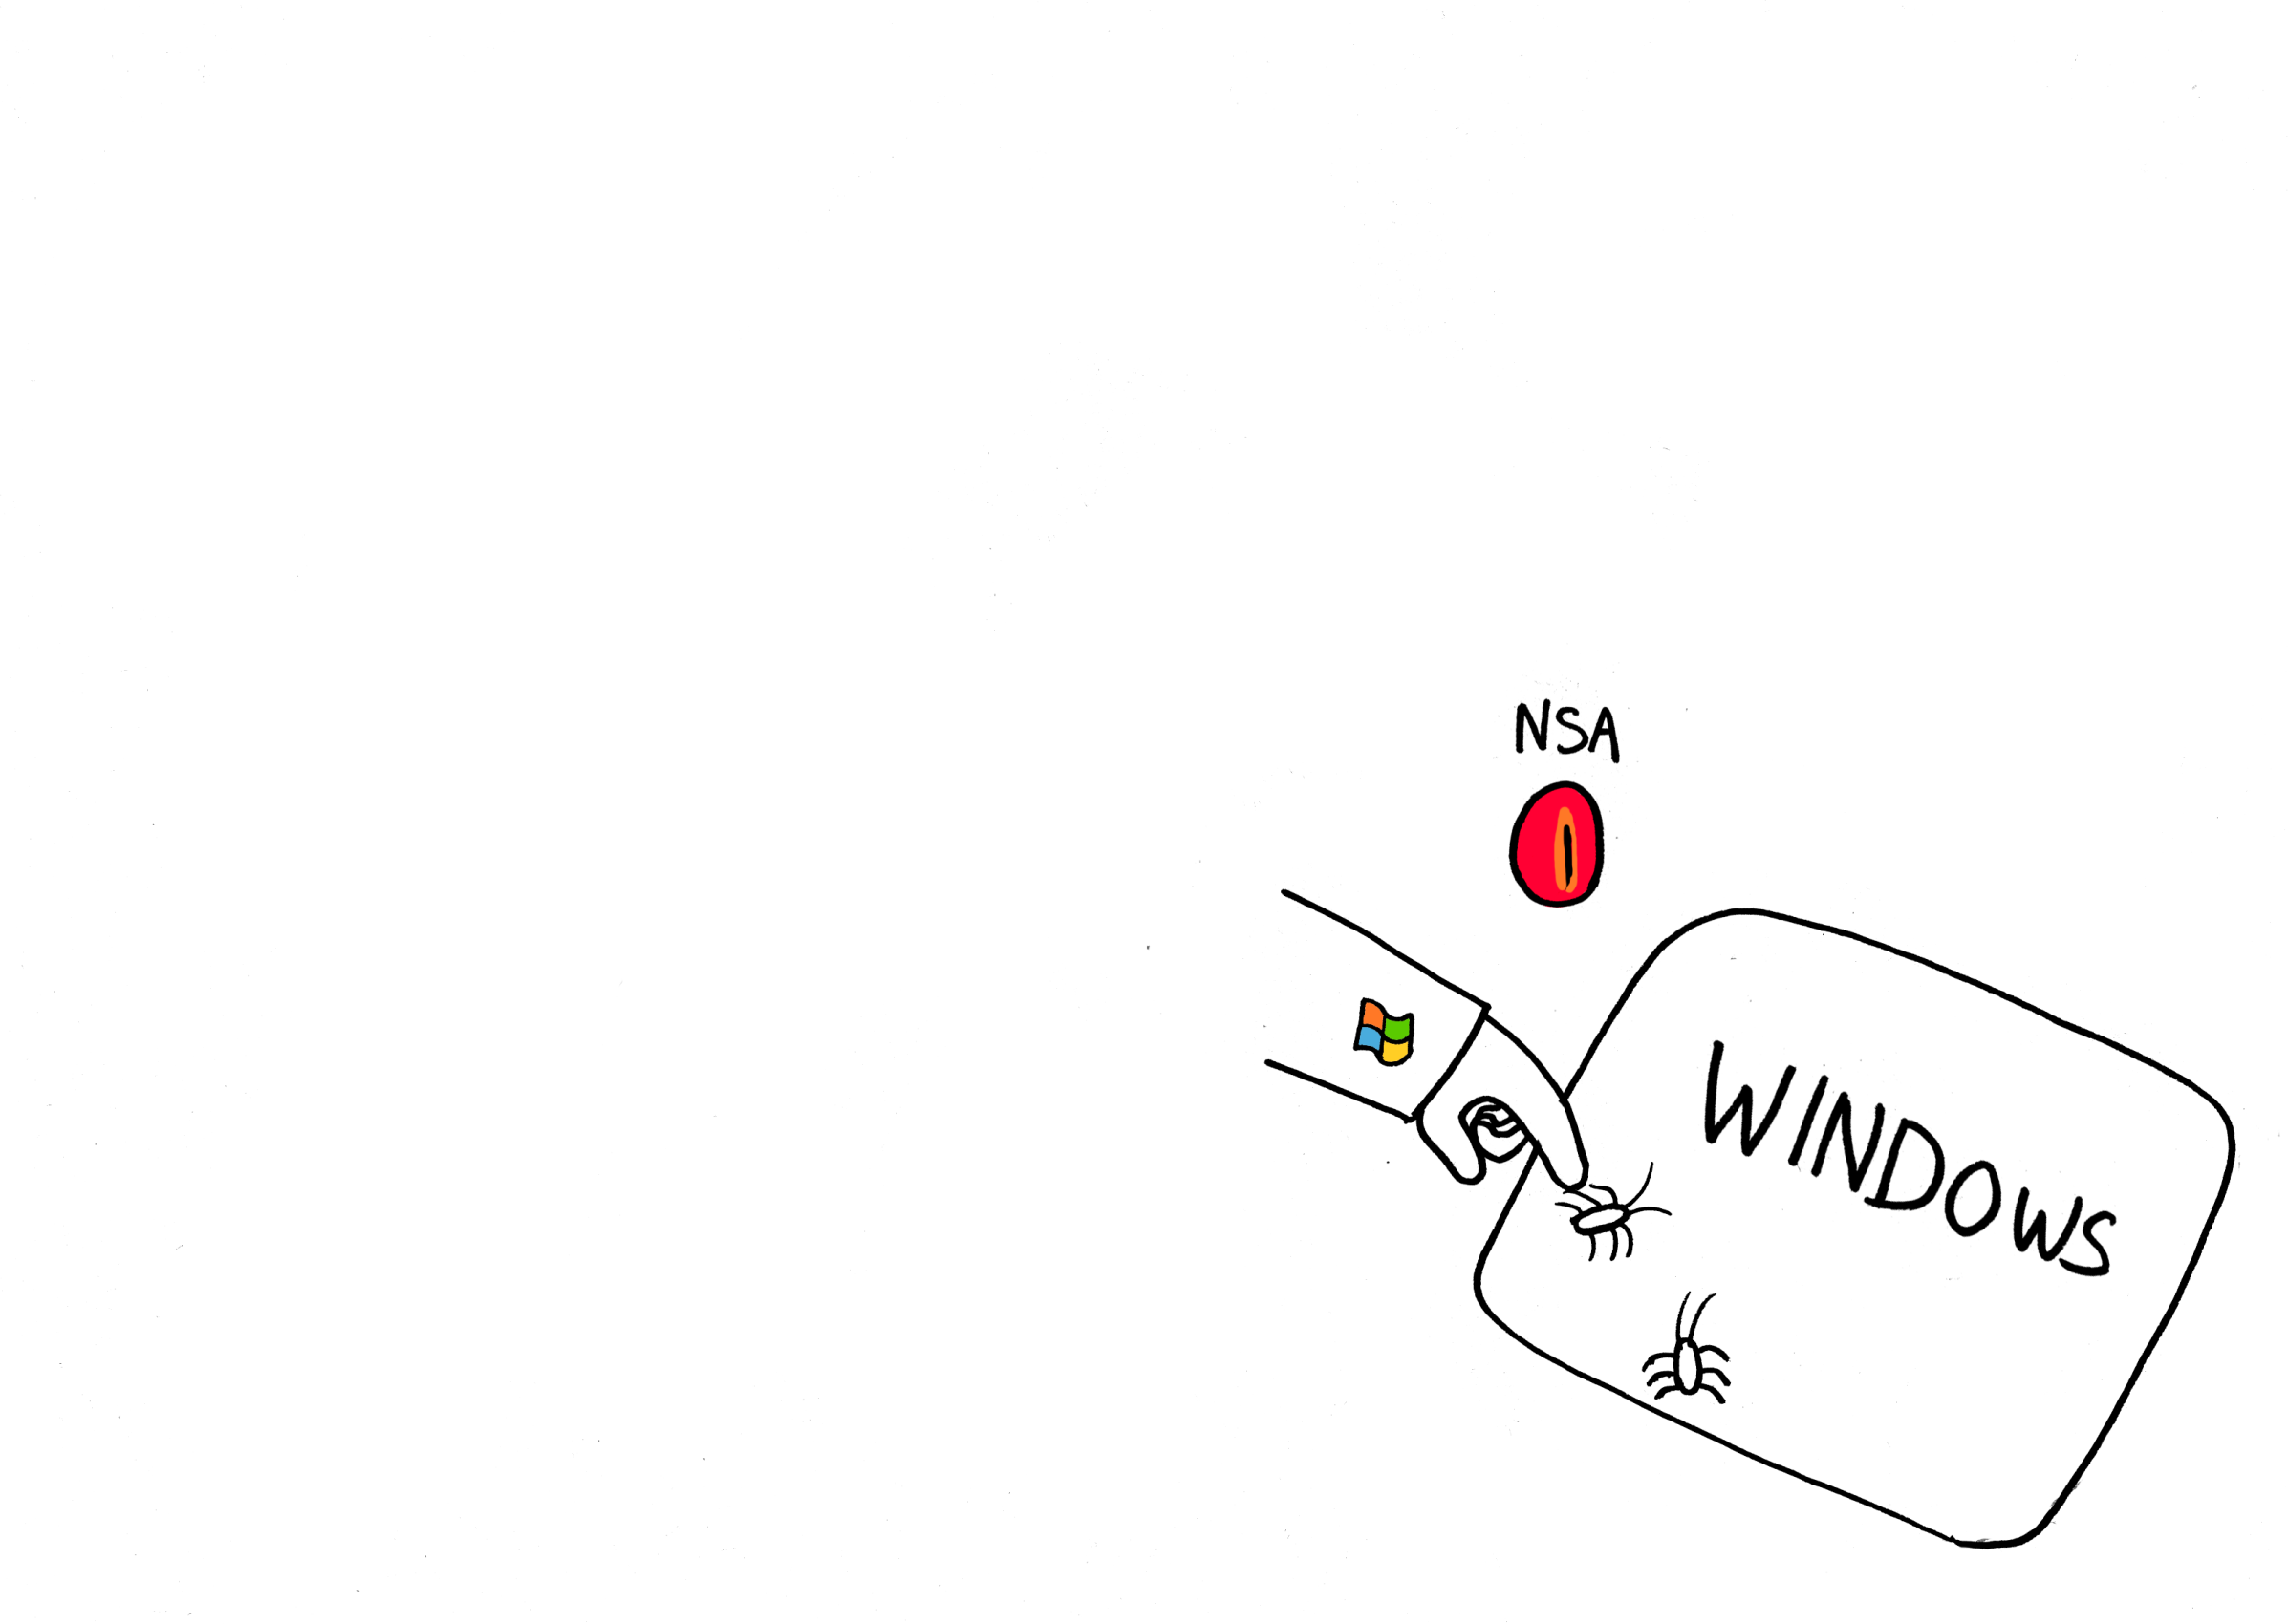
Msoft helps NSA attack

Slide 36
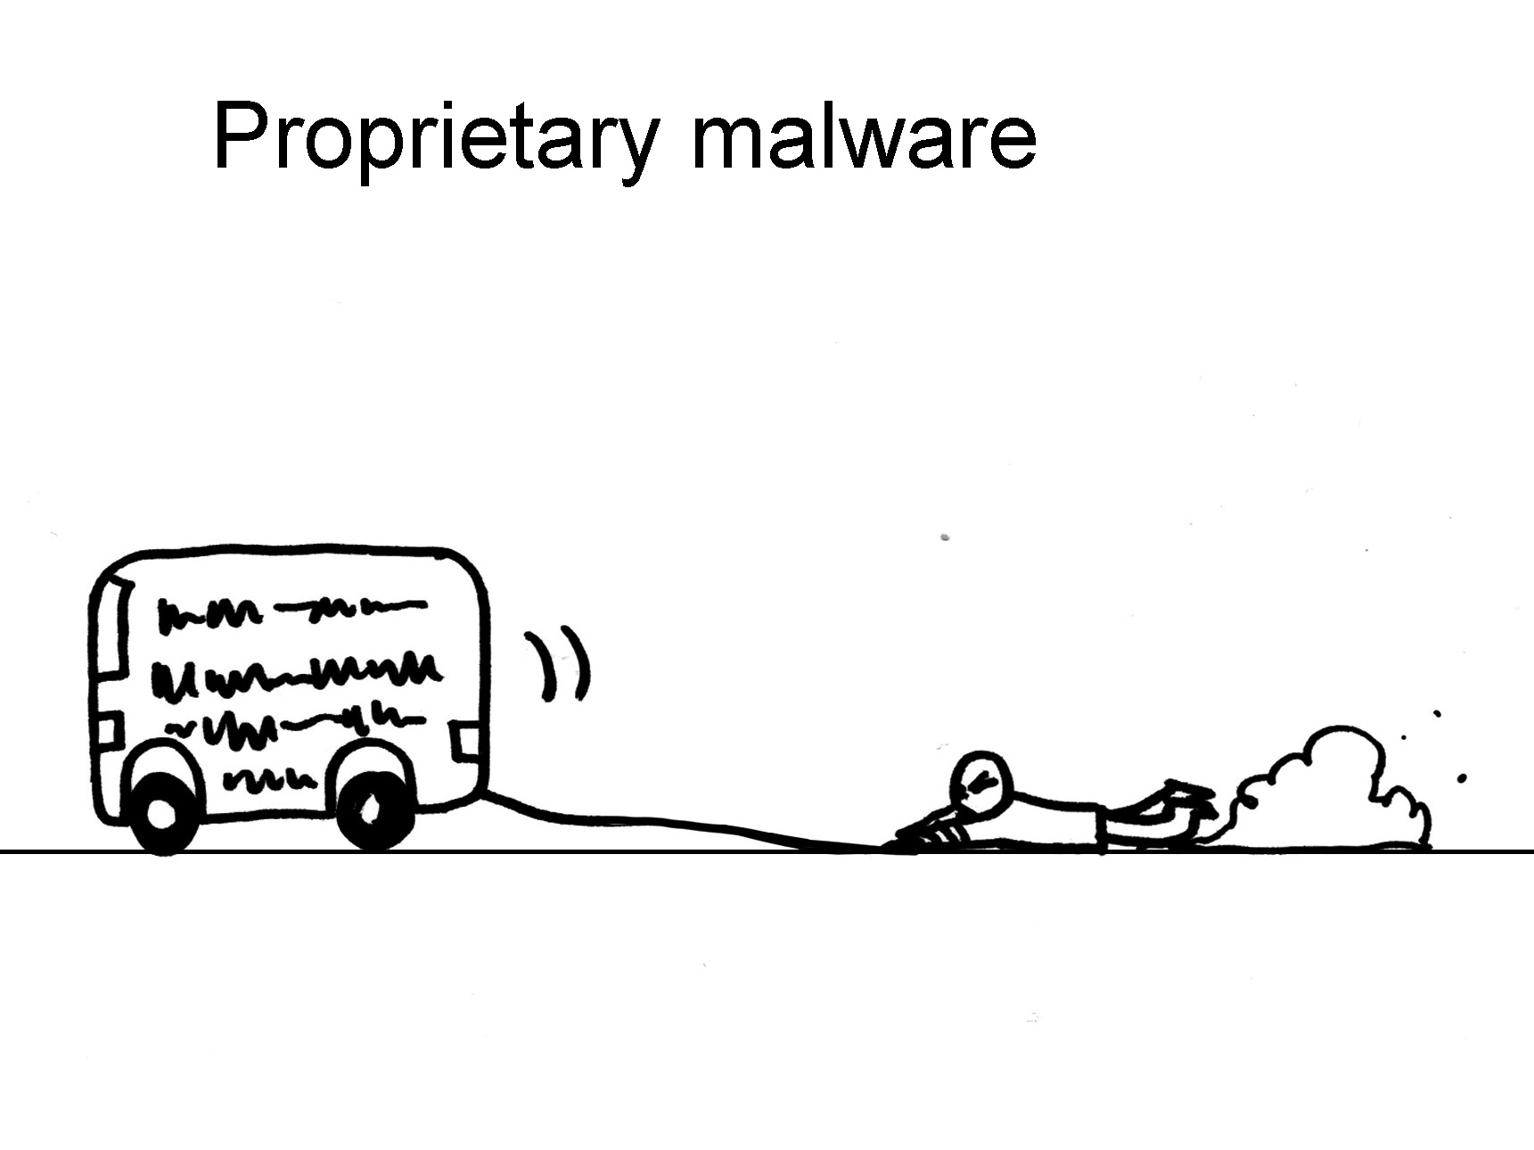

Slide 37
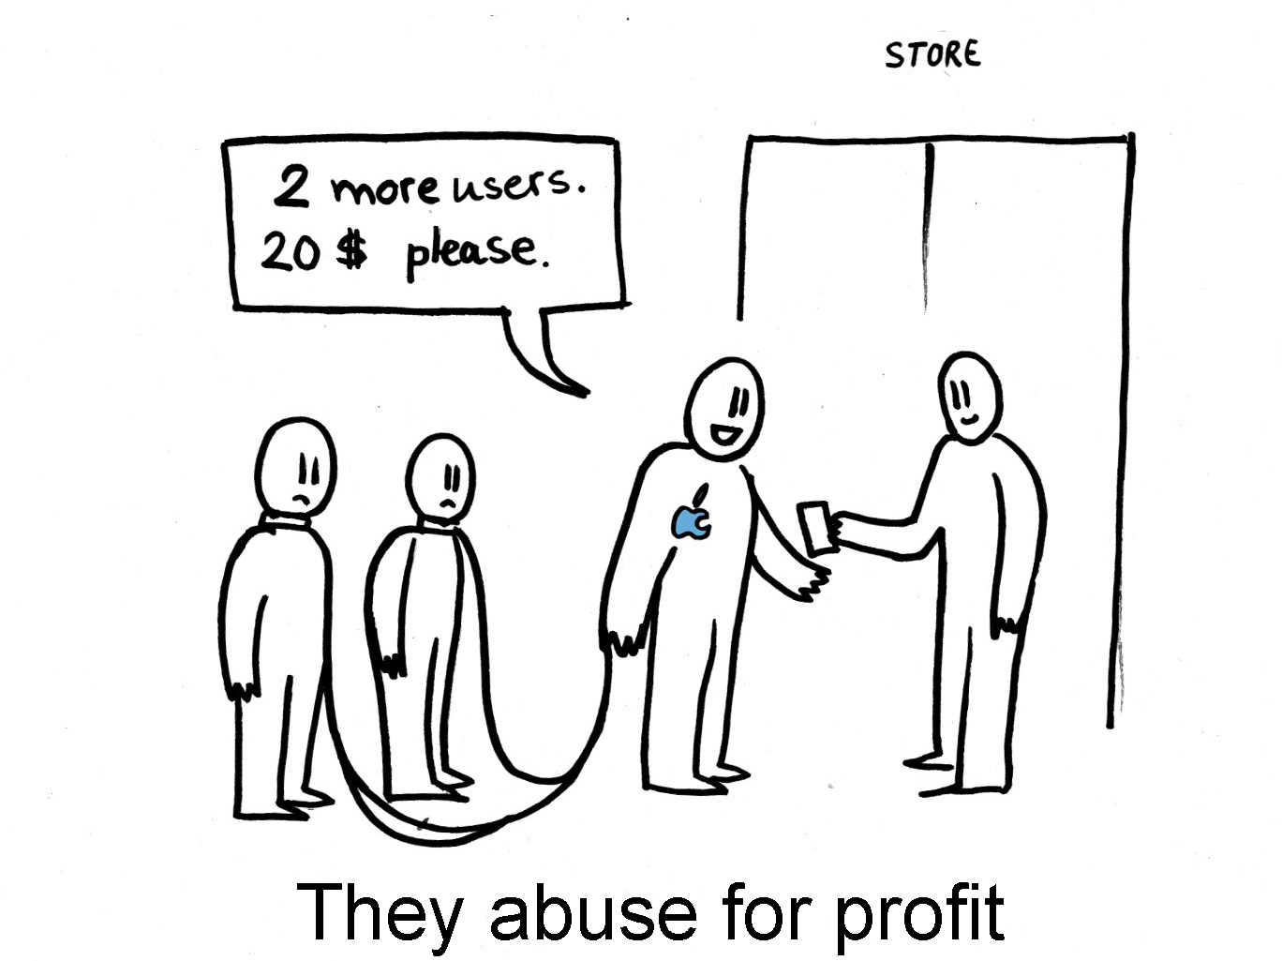

Slide 38
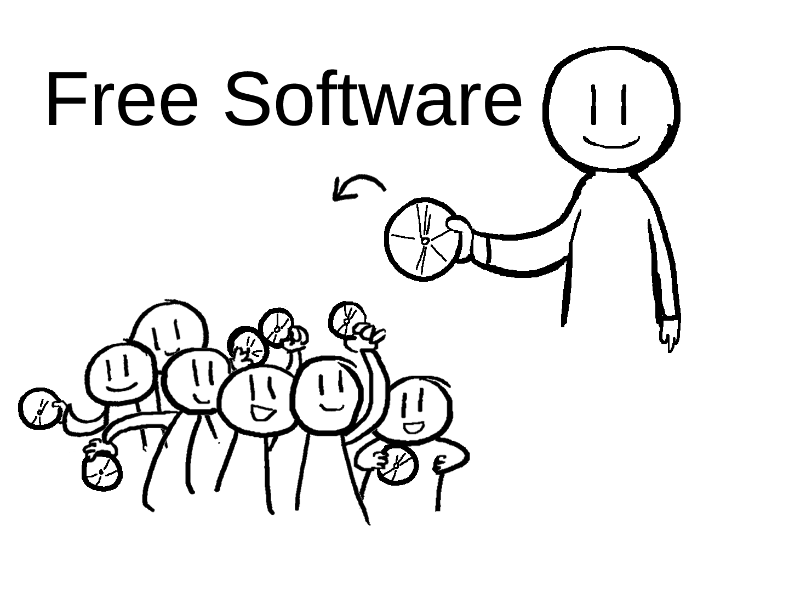

Slide 39
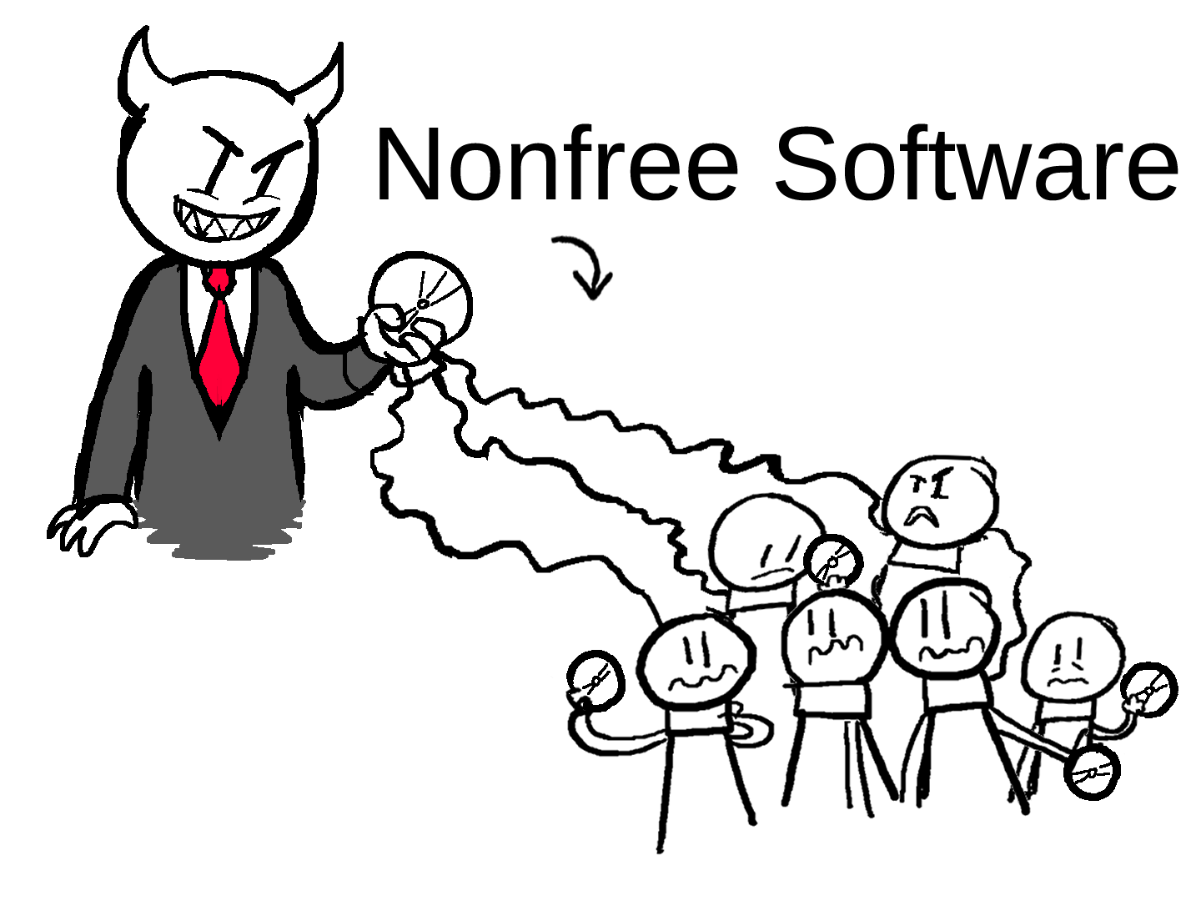

Slide 40
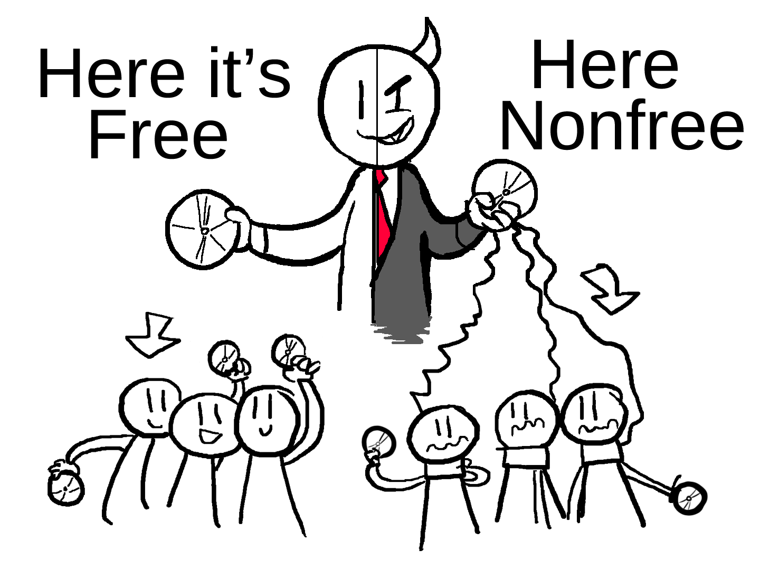

Slide 41
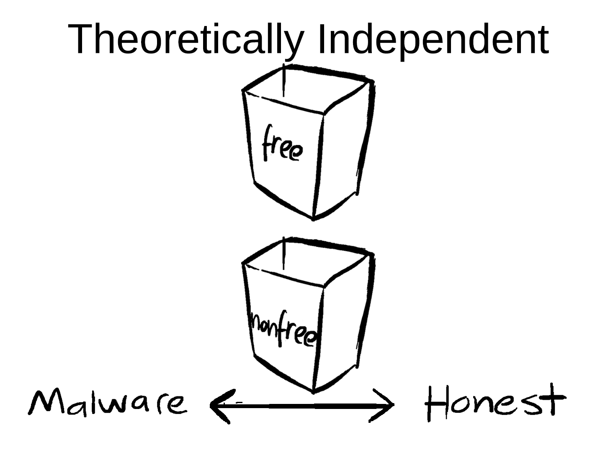

Slide 42
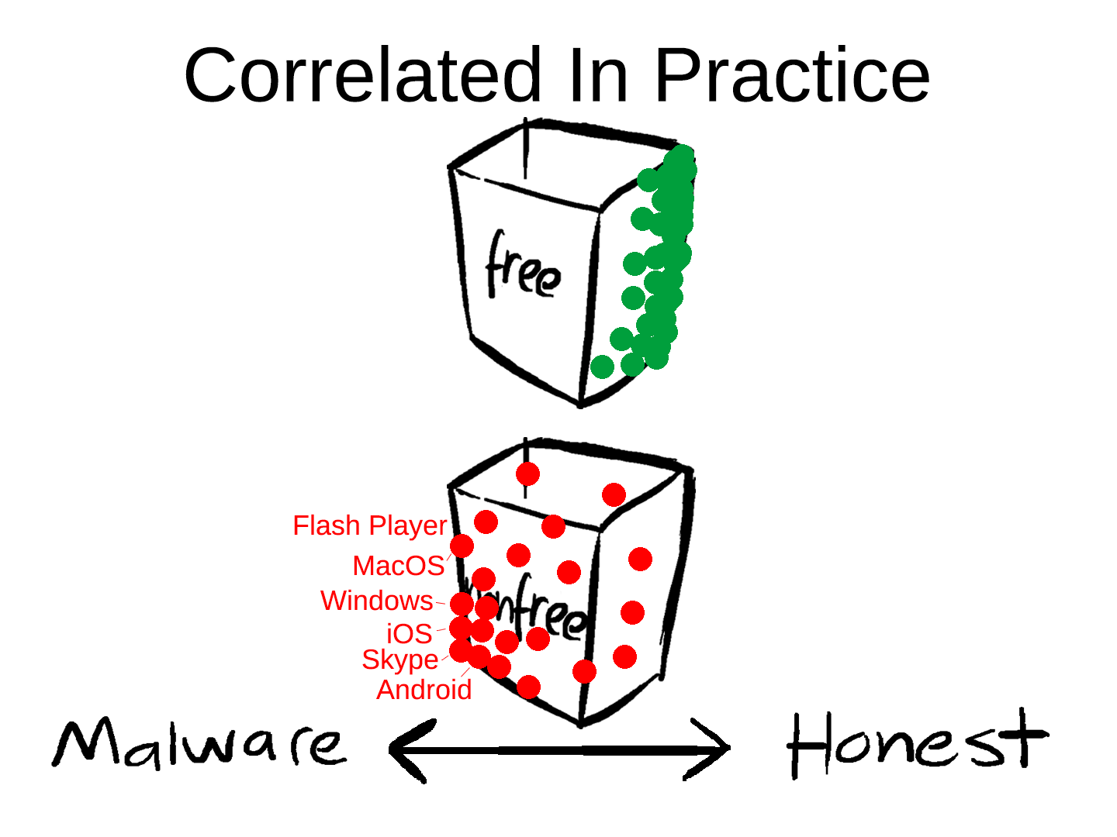

Slide 43
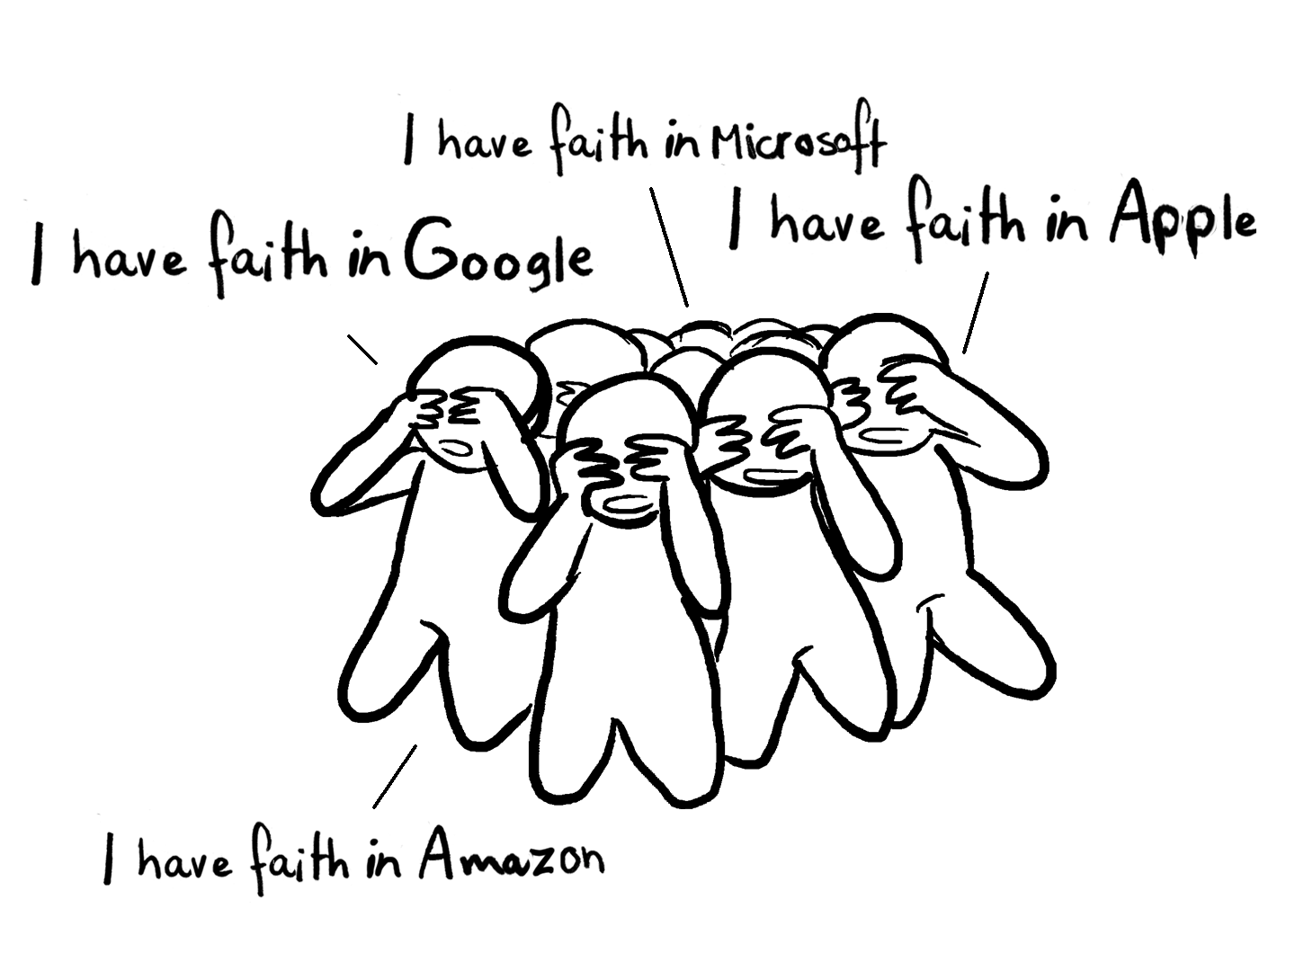
Nonfree: Blind Faith Required

Slide 44
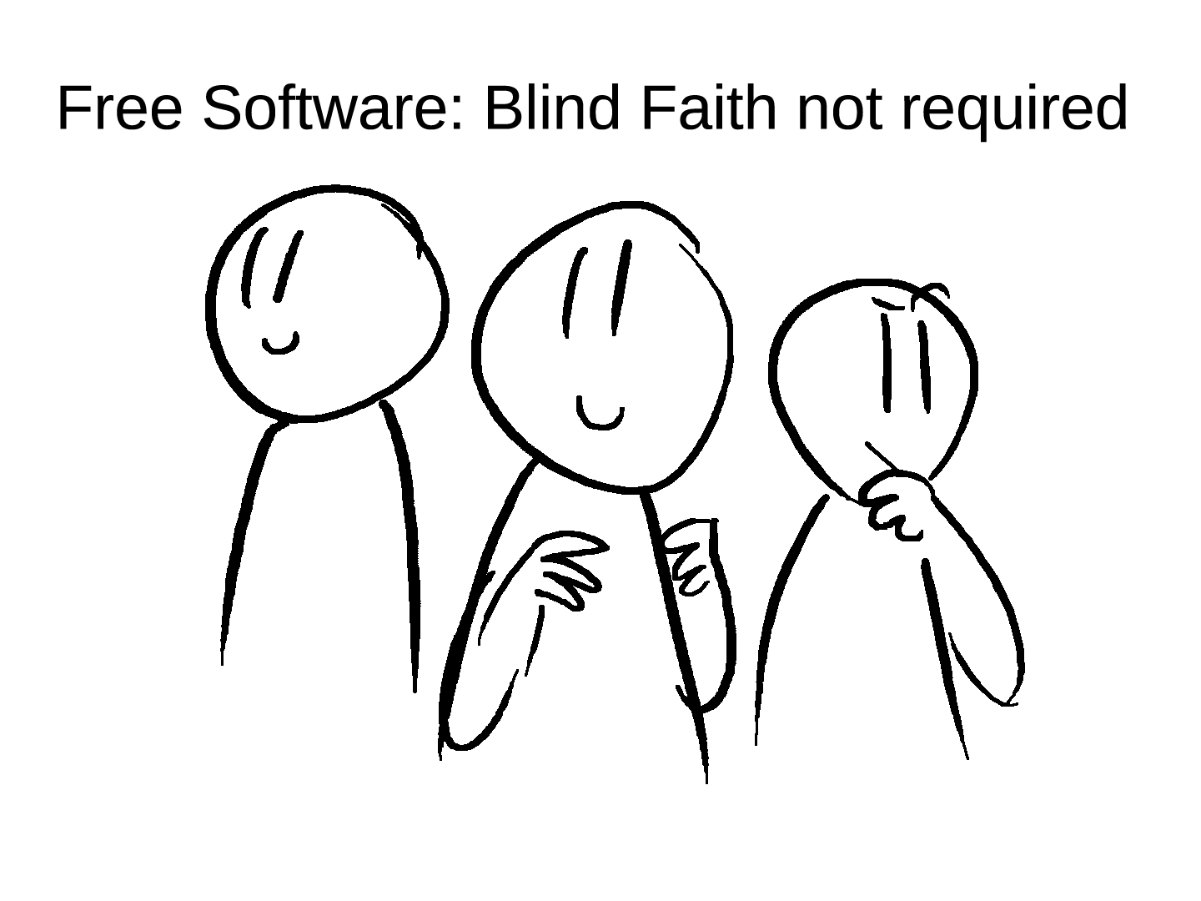
Free: Rational Trust Possible

Slide 45
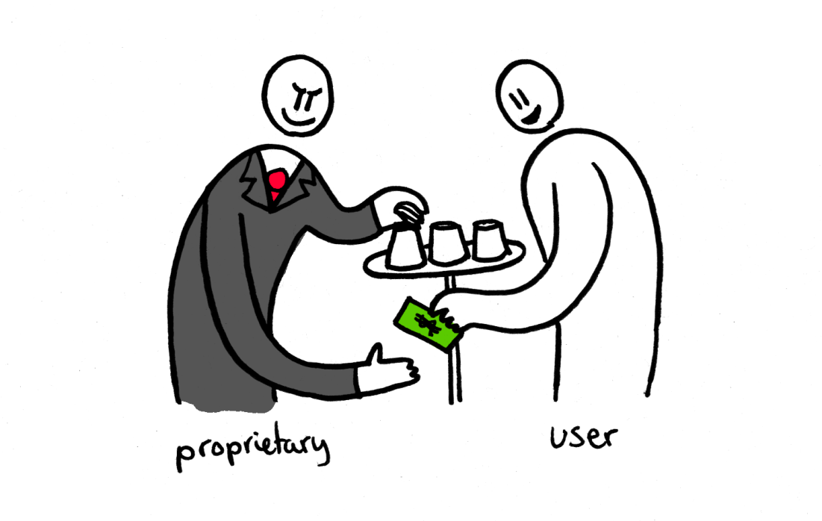

Slide 46
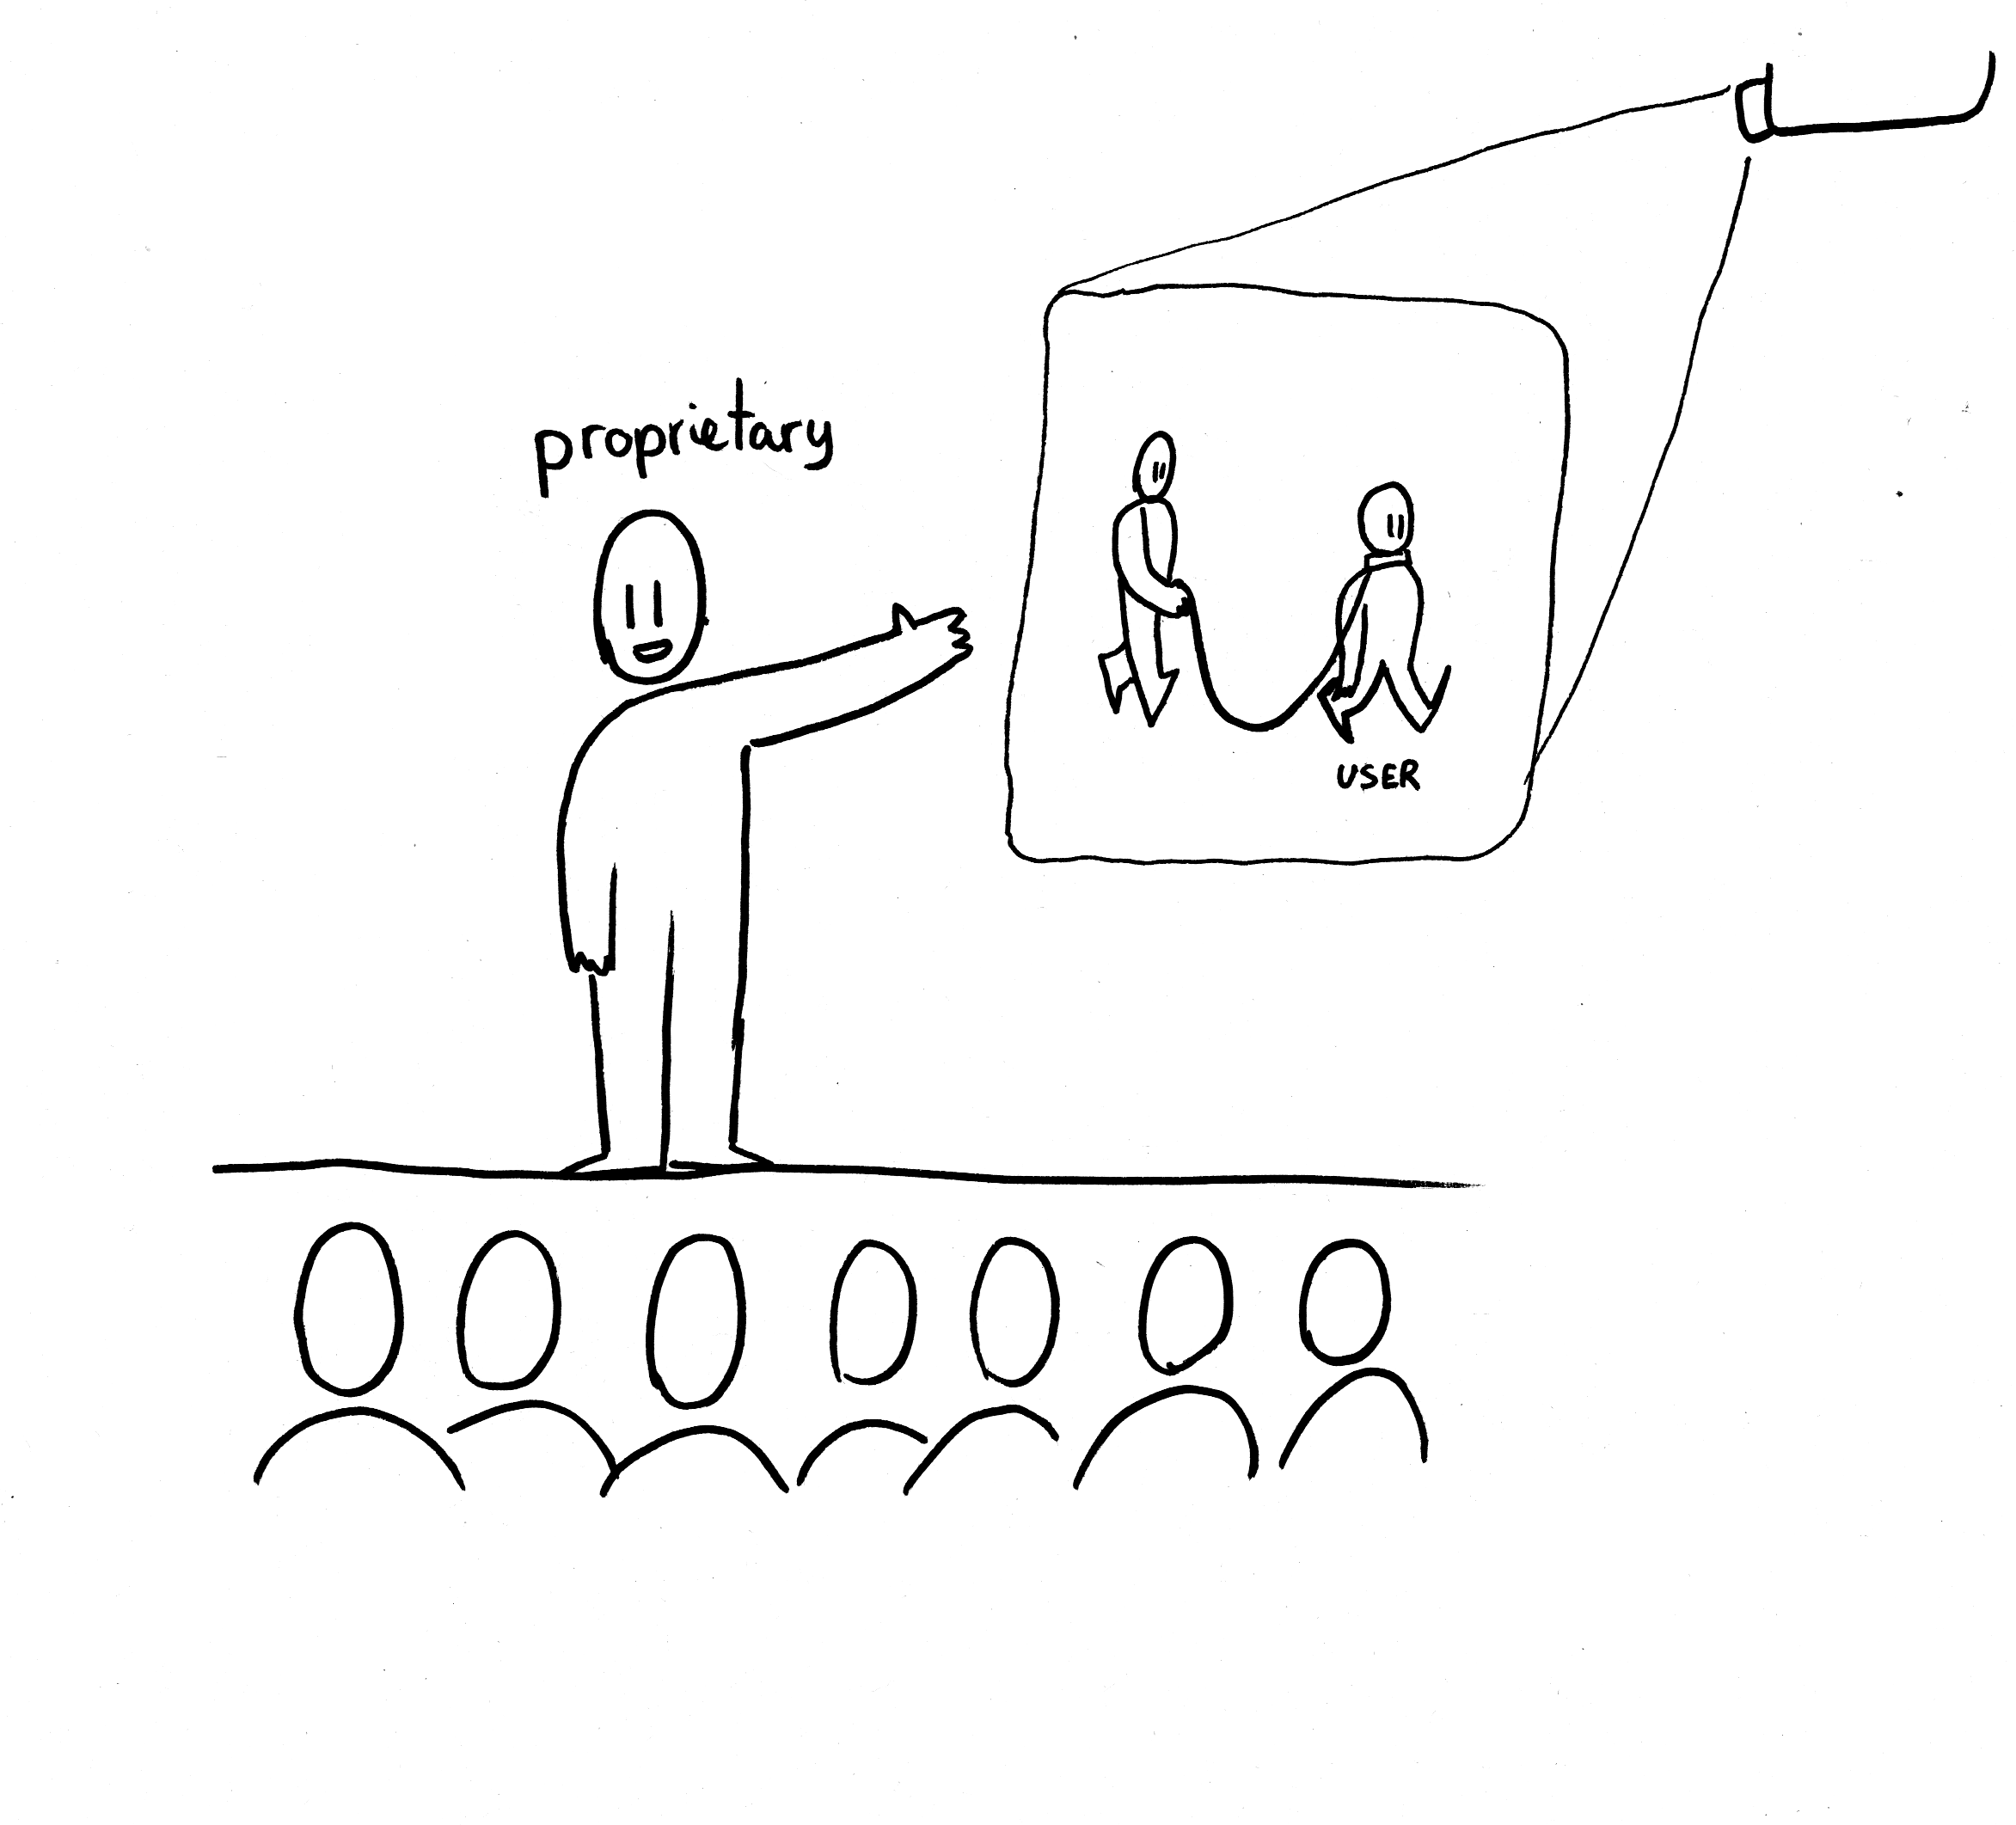

Slide 47
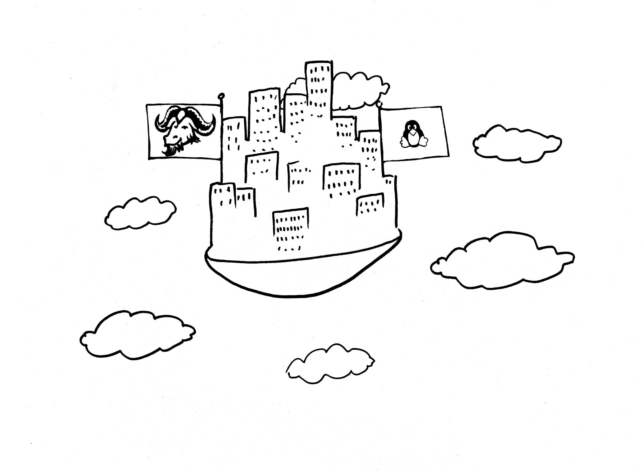

Slide 48
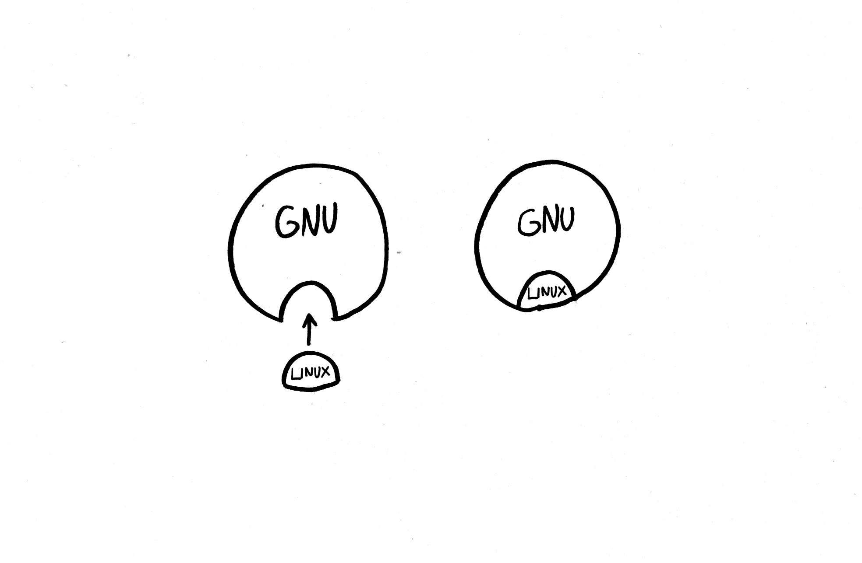
1984 1992
1991

Slide 49
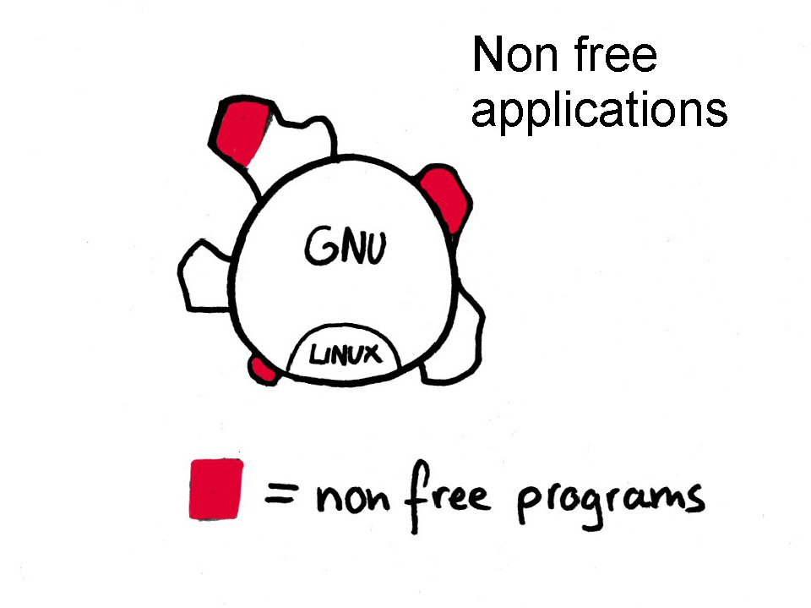

Slide 50
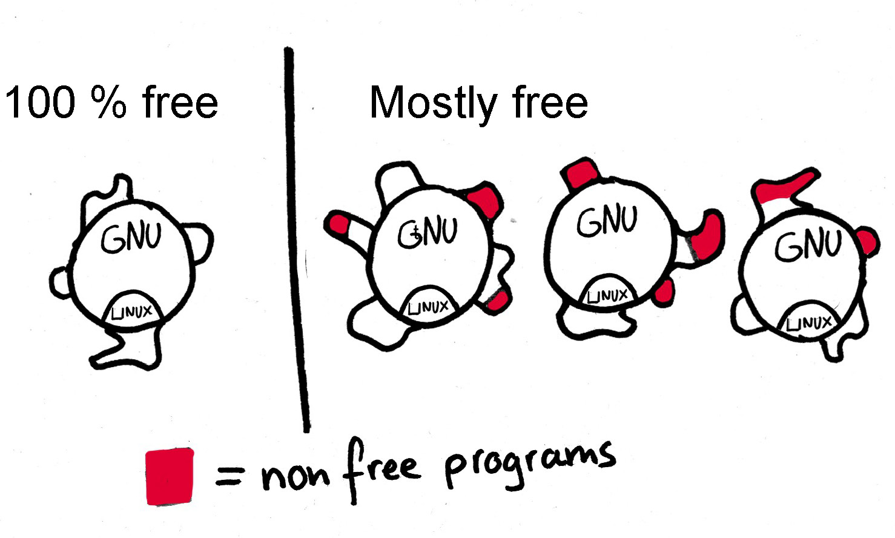
Free Distros gnu.org/distros

Slide 51
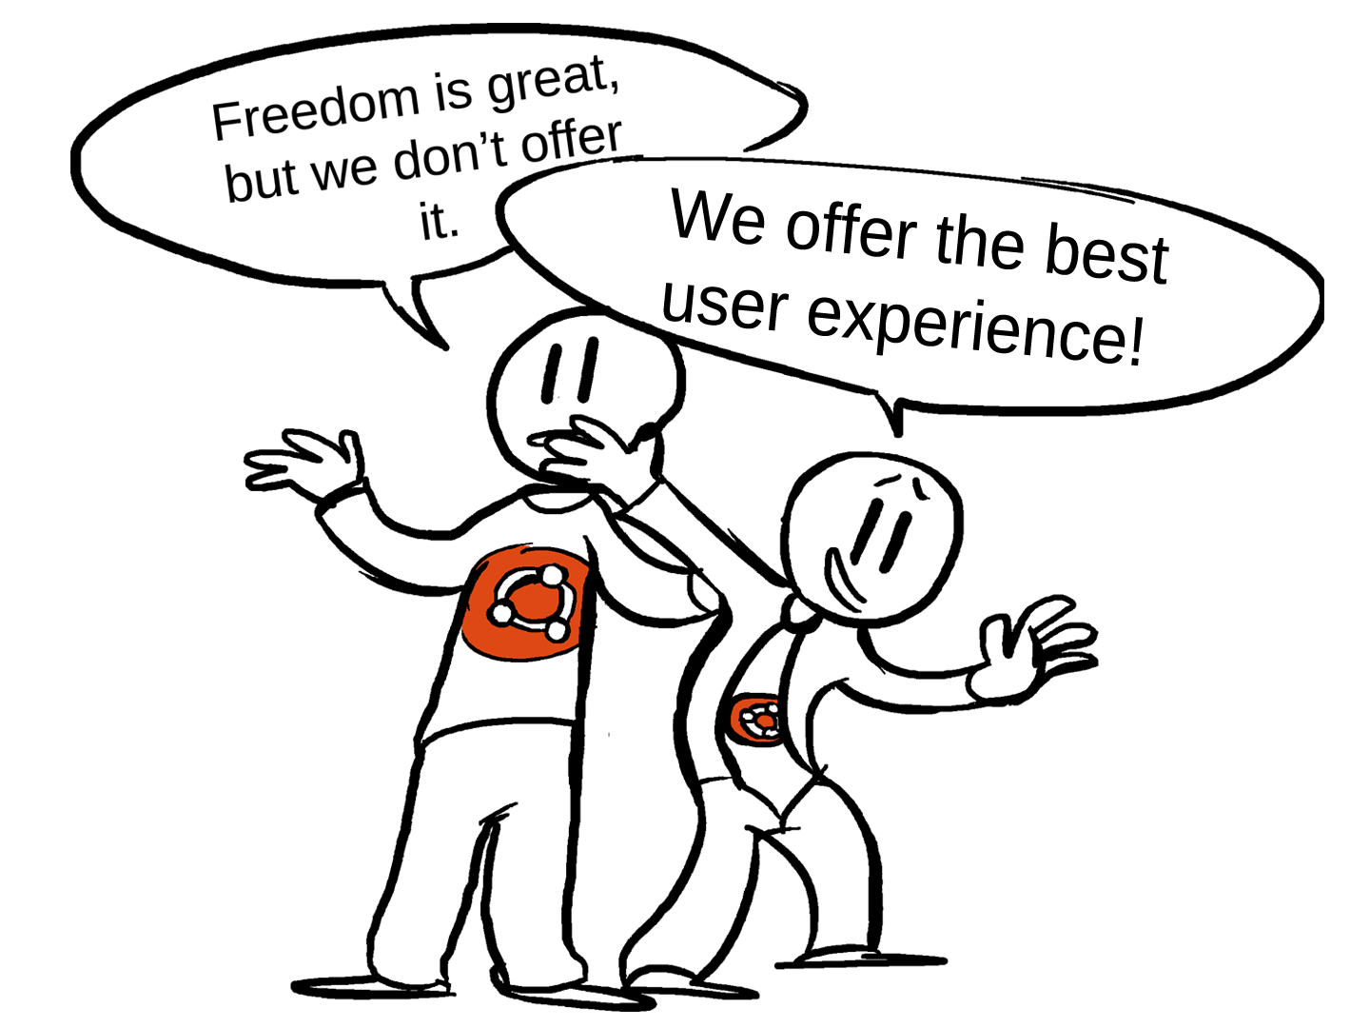

Slide 52
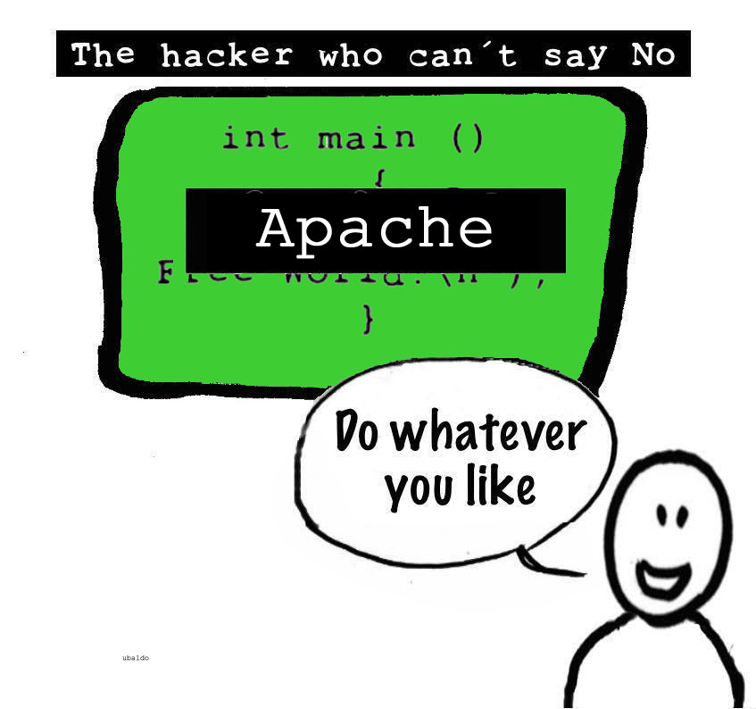

Slide 53


Slide 54


Slide 55


Slide 56


Slide 57


Slide 58


Slide 59


Slide 60


Slide 61


Slide 62


Slide 63


Slide 64


Slide 65


Slide 66


Slide 67

Never teach dependence

Slide 68


Slide 69


Slide 70


Slide 71


Slide 72


Slide 73

72 write free software

Slide 74


Slide 75


Slide 76


Slide 77


Slide 78
gnu.org/help
/philosophy /licenses
/government /education
/gnu /malware /distros

